Slide 1

Begbroke: design competition
Stage 1 design boards

Slide 2
AHMM
Arup; Gillespies (Oxford); Green Infrastructure Consultancy; Targeting
Zero

Slide 3
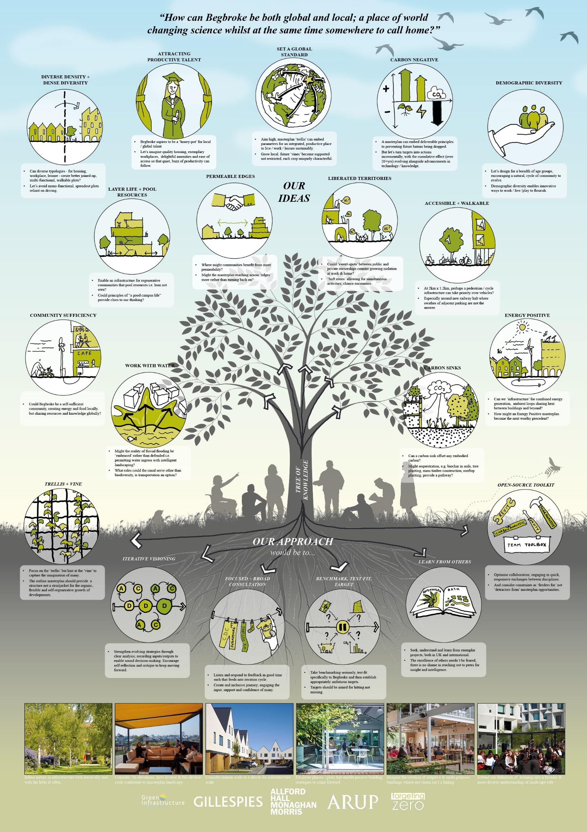

Slide 4
Allies and Morrison
Mecanoo (Netherlands); Gort Scott; DK-CM; Hargreaves Jones (USA);
BuroHappold; Systematica (USA); HR&A (USA)

Slide 5
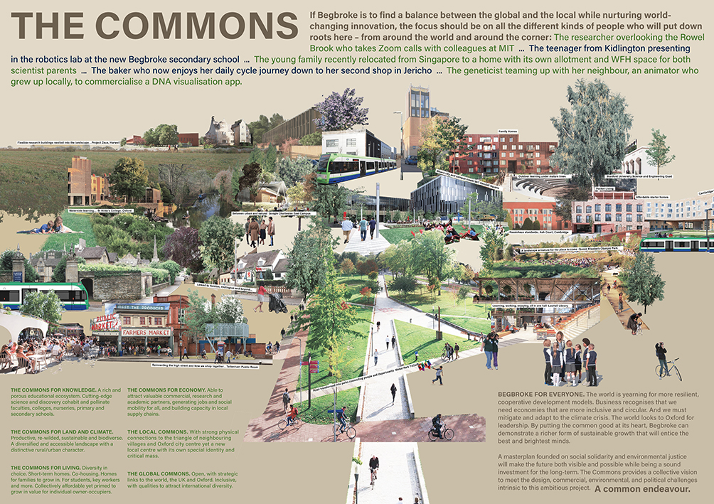

Slide 6
Apt
Matthew Lloyd Architects; Place Design & Planning; XCO2; Expedition;
Velocity Transport Planning

Slide 7
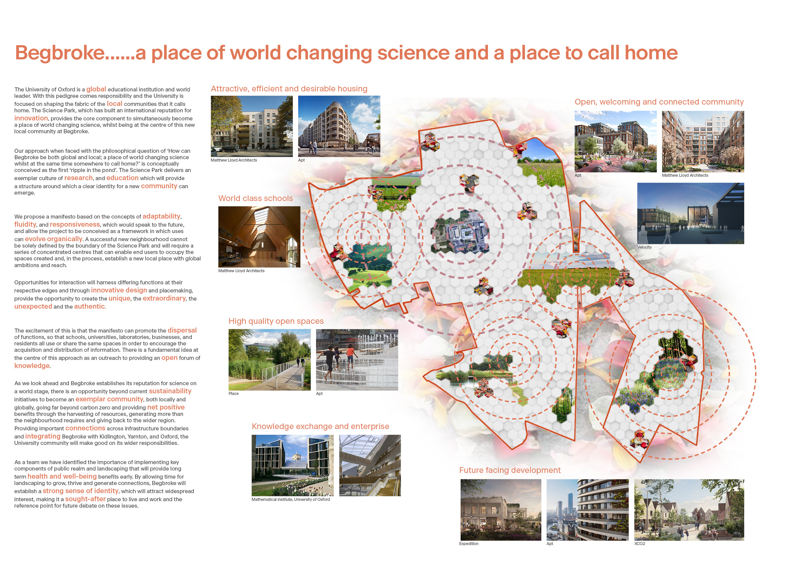

Slide 8
Arup
David Kohn Architects; Adam Khan Architects; Stoss Landscape
Urbanism (USA); Nigel Dunnett; Material Cultures; Places for People

Slide 9
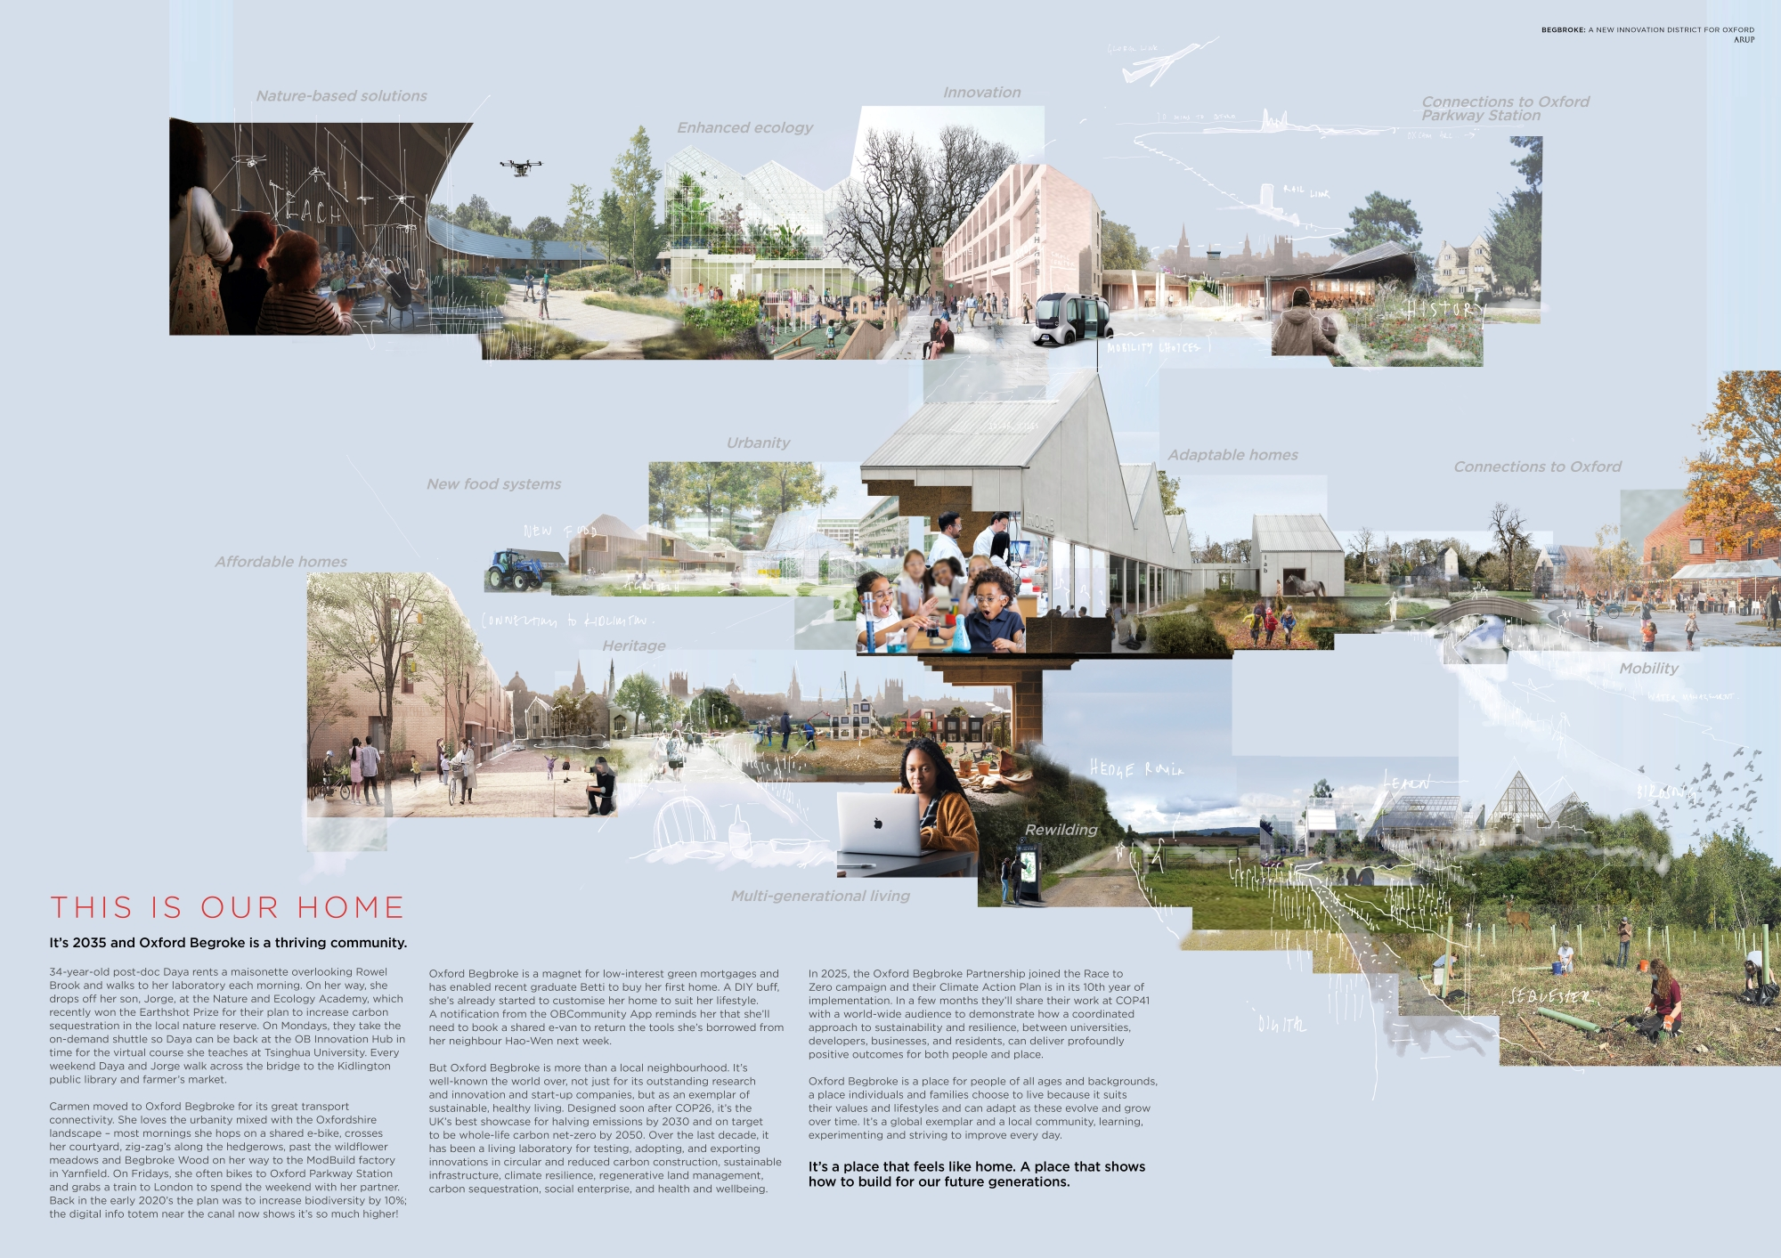

Slide 10
Barton Willmore
Nicholas Hare Architects; Stantec; 3Adapt; PJA

Slide 12
BDP working with URBED
Steer; Human Space

Slide 13
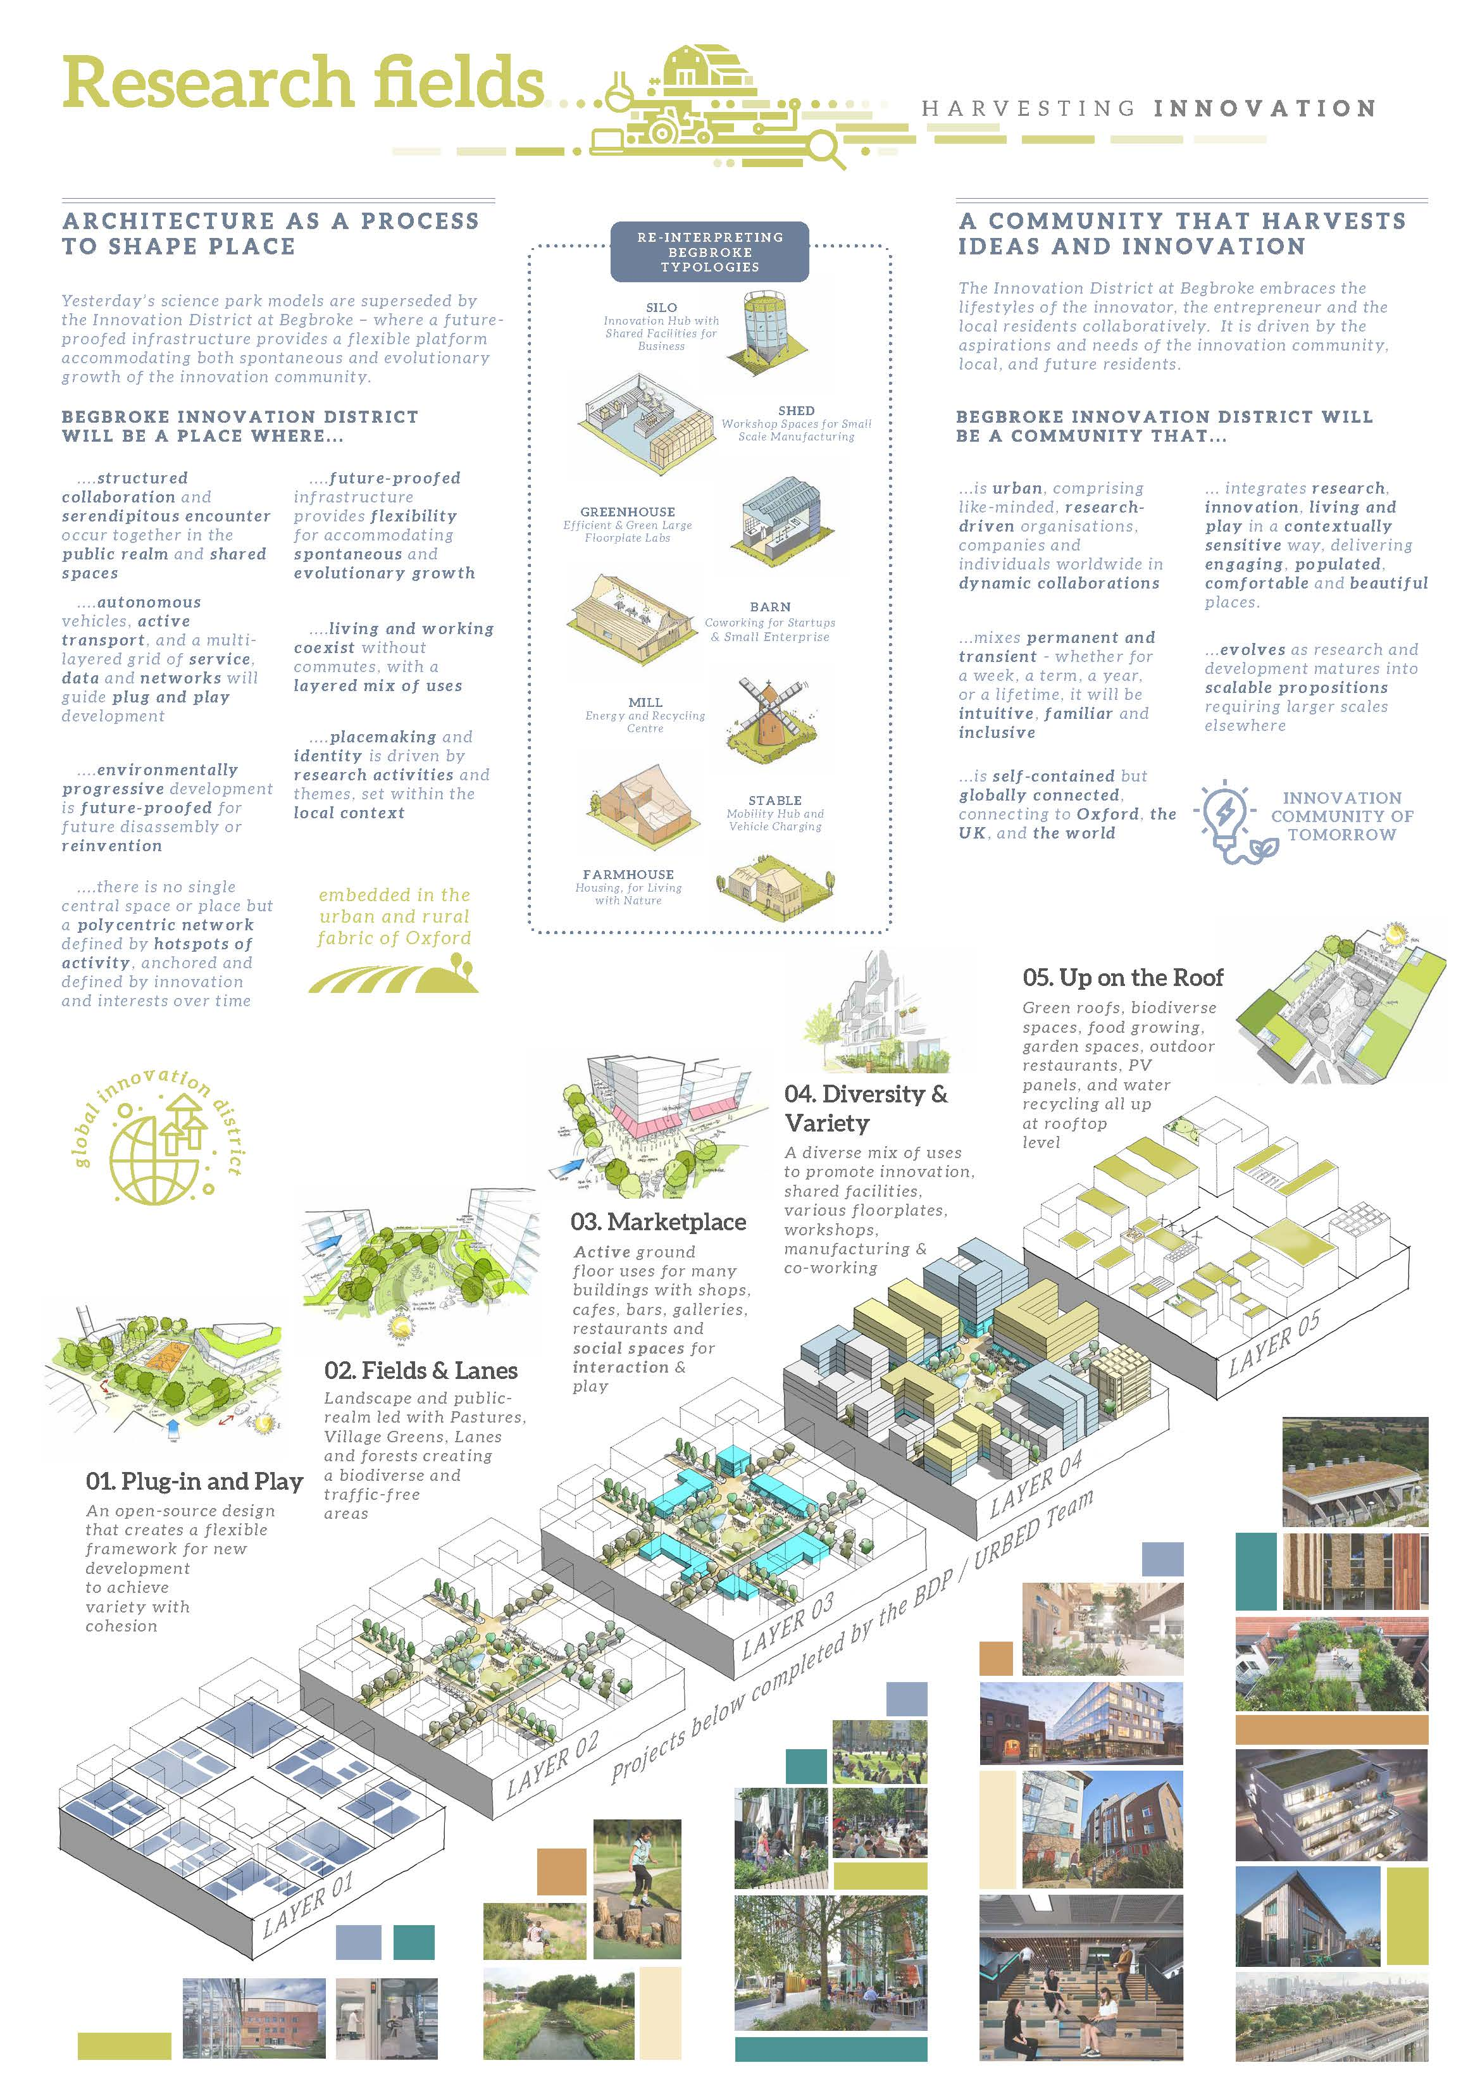

Slide 14
BIG working with Studio Weave
AKTii; Atelier Ten; BuroHappold; FutureCity; Msafe; The Townscape
Consultancy

Slide 15
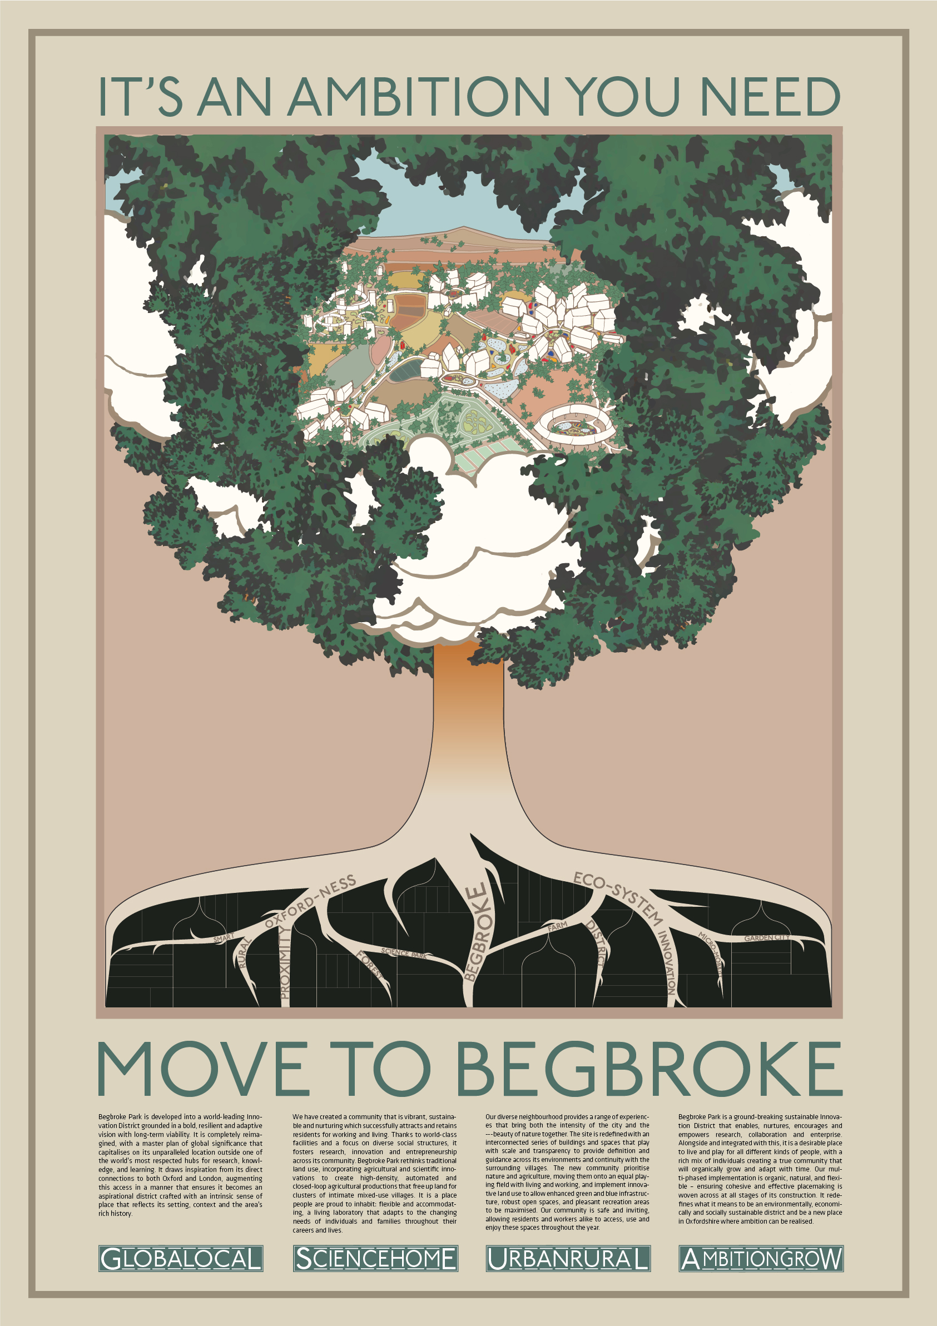

Slide 16
Carlo Ratti Associati
Outcomist; Martha Schwartz Partners; Ove Arup & Partners; Studio 20-20;
Groupwork Architects; Tsuruta Architects; Theatrum Mundi; Fabienne
Nicholas; Mobility in Chain; Soundings; Indeed Innovation (Germany)

Slide 17
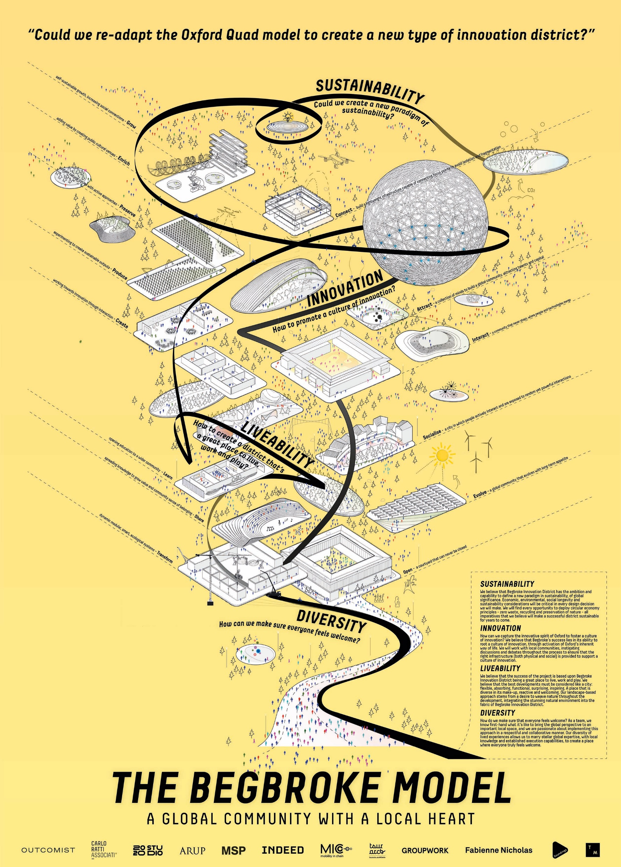

Slide 18
CF Møller
Third Nature (Denmark); Galmstrup Architects; AKT II; XC02; Studio 4215;
Urban Movement; Plan A Consultants

Slide 19
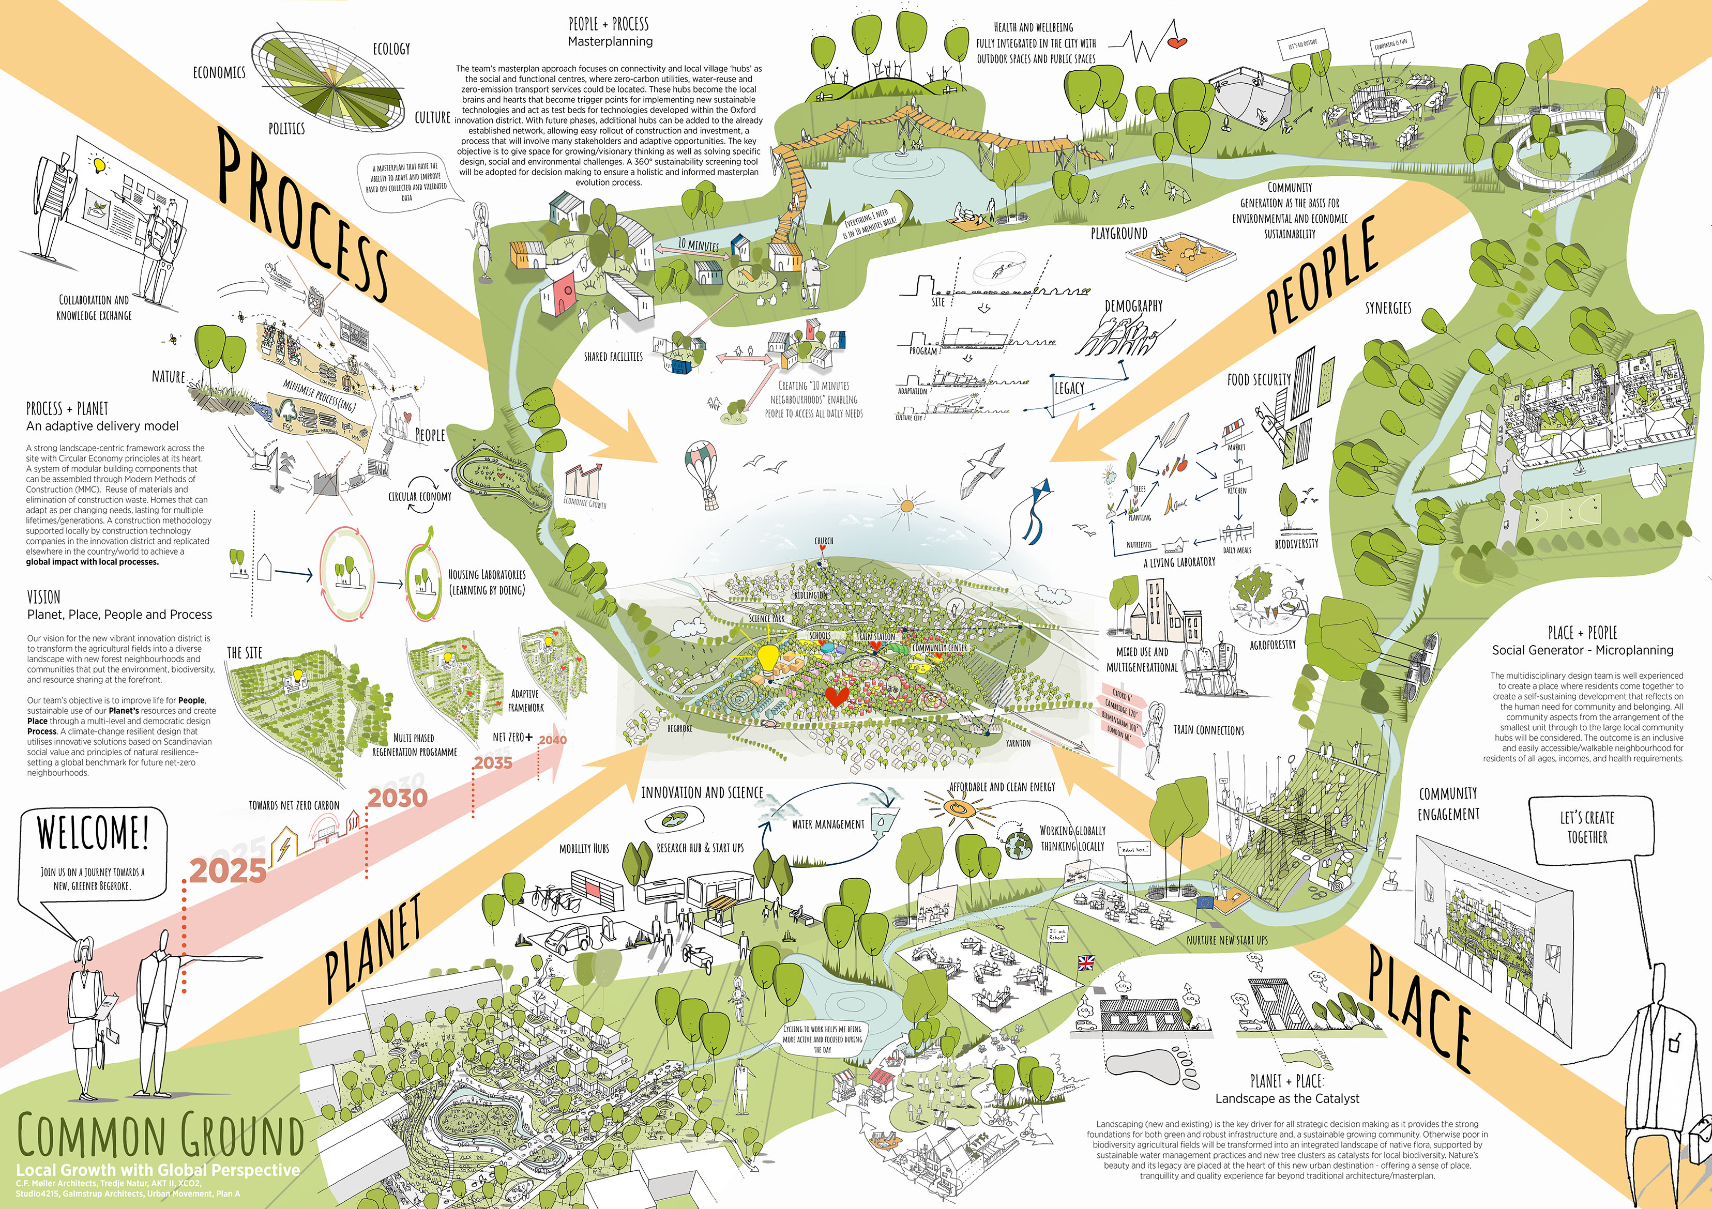

Slide 20
Eric Parry
Child Graddon Lews; Cottrell & Vermeulen; Todd Longstaffe-Gowan; Max Fordham; AKT II; Carolyn Steel; Oxford Brooks University (Oxford); Space Syntax; PRD; Ridge (Oxford)

Slide 21
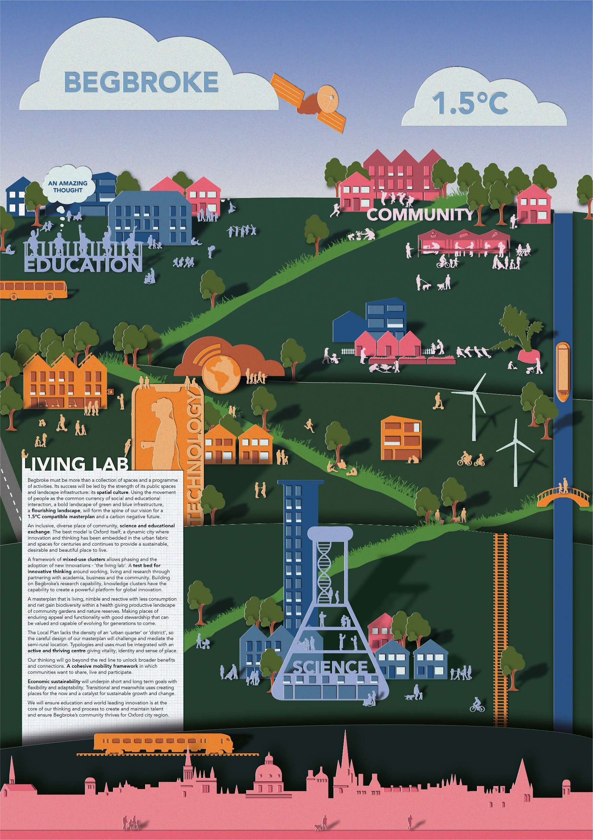

Slide 22
Farrells
BuroHappold; Exterior Architecture; Office S&M; Studio SOUR (USA)

Slide 23
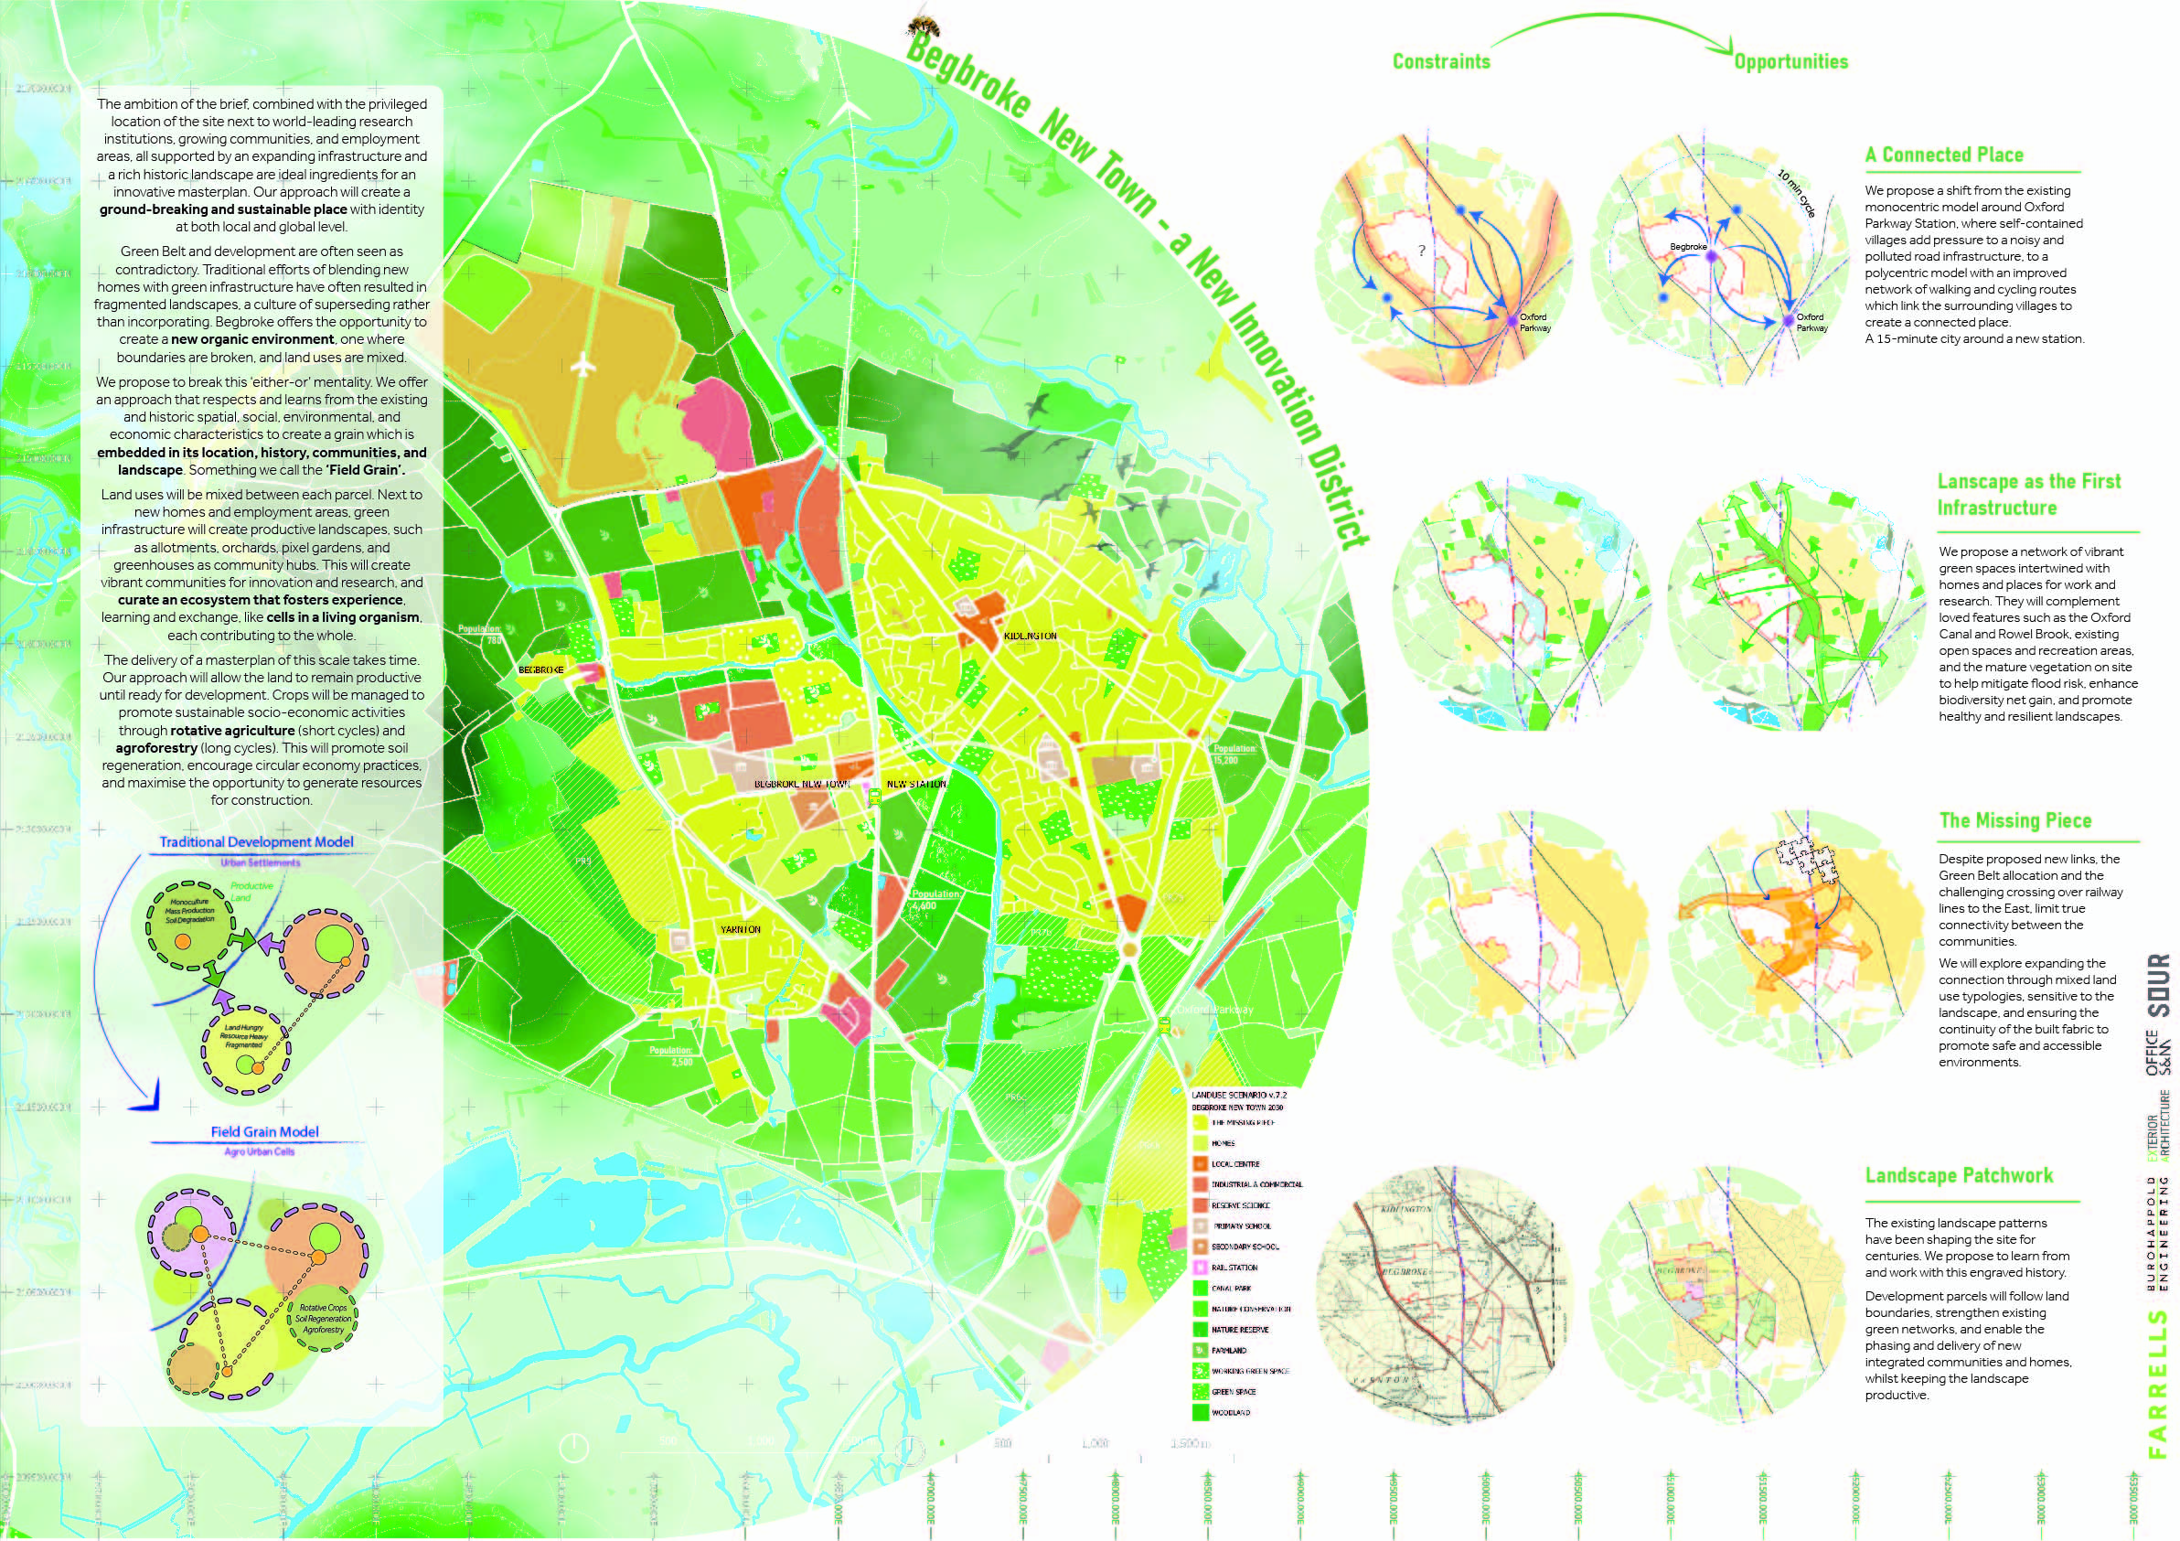

Slide 24
FCBS
5th Studio; Architecture00; Feilden Fowles; Expedition Engineering;
Atelier Ten; Momentum; Grant Associates; Biodiversity by Design

Slide 25
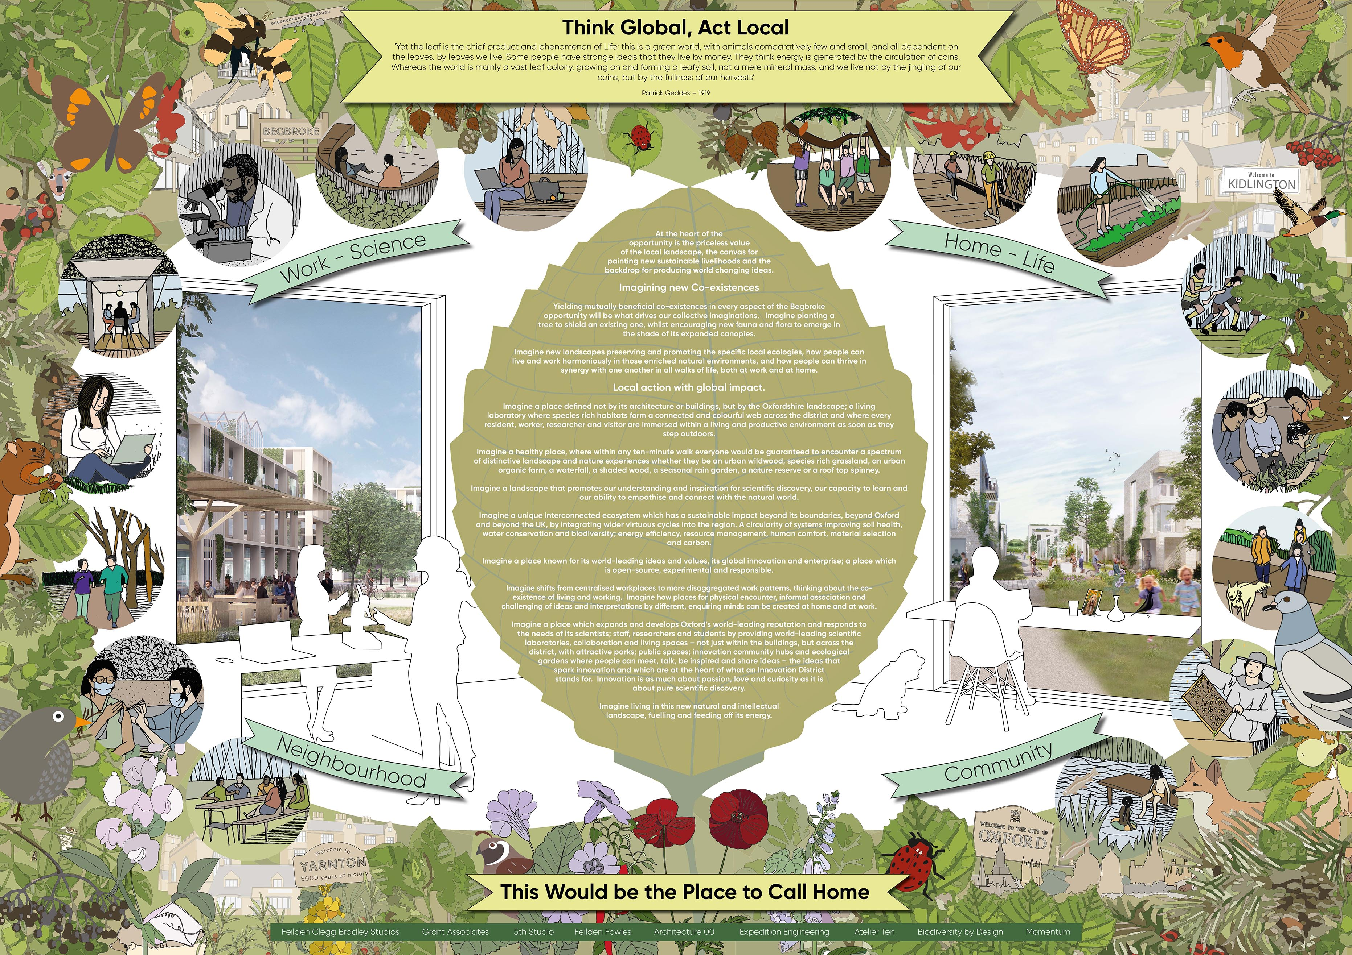

Slide 26
Gensler
CoLab Consulting Group (Oxford); WSP; Ridge (Oxford); PRP; Bioregional;
Ecology by Design; TALA (Oxford); Community First Oxfordshire (Oxford);
Low Carbon Hub (Oxford)

Slide 27
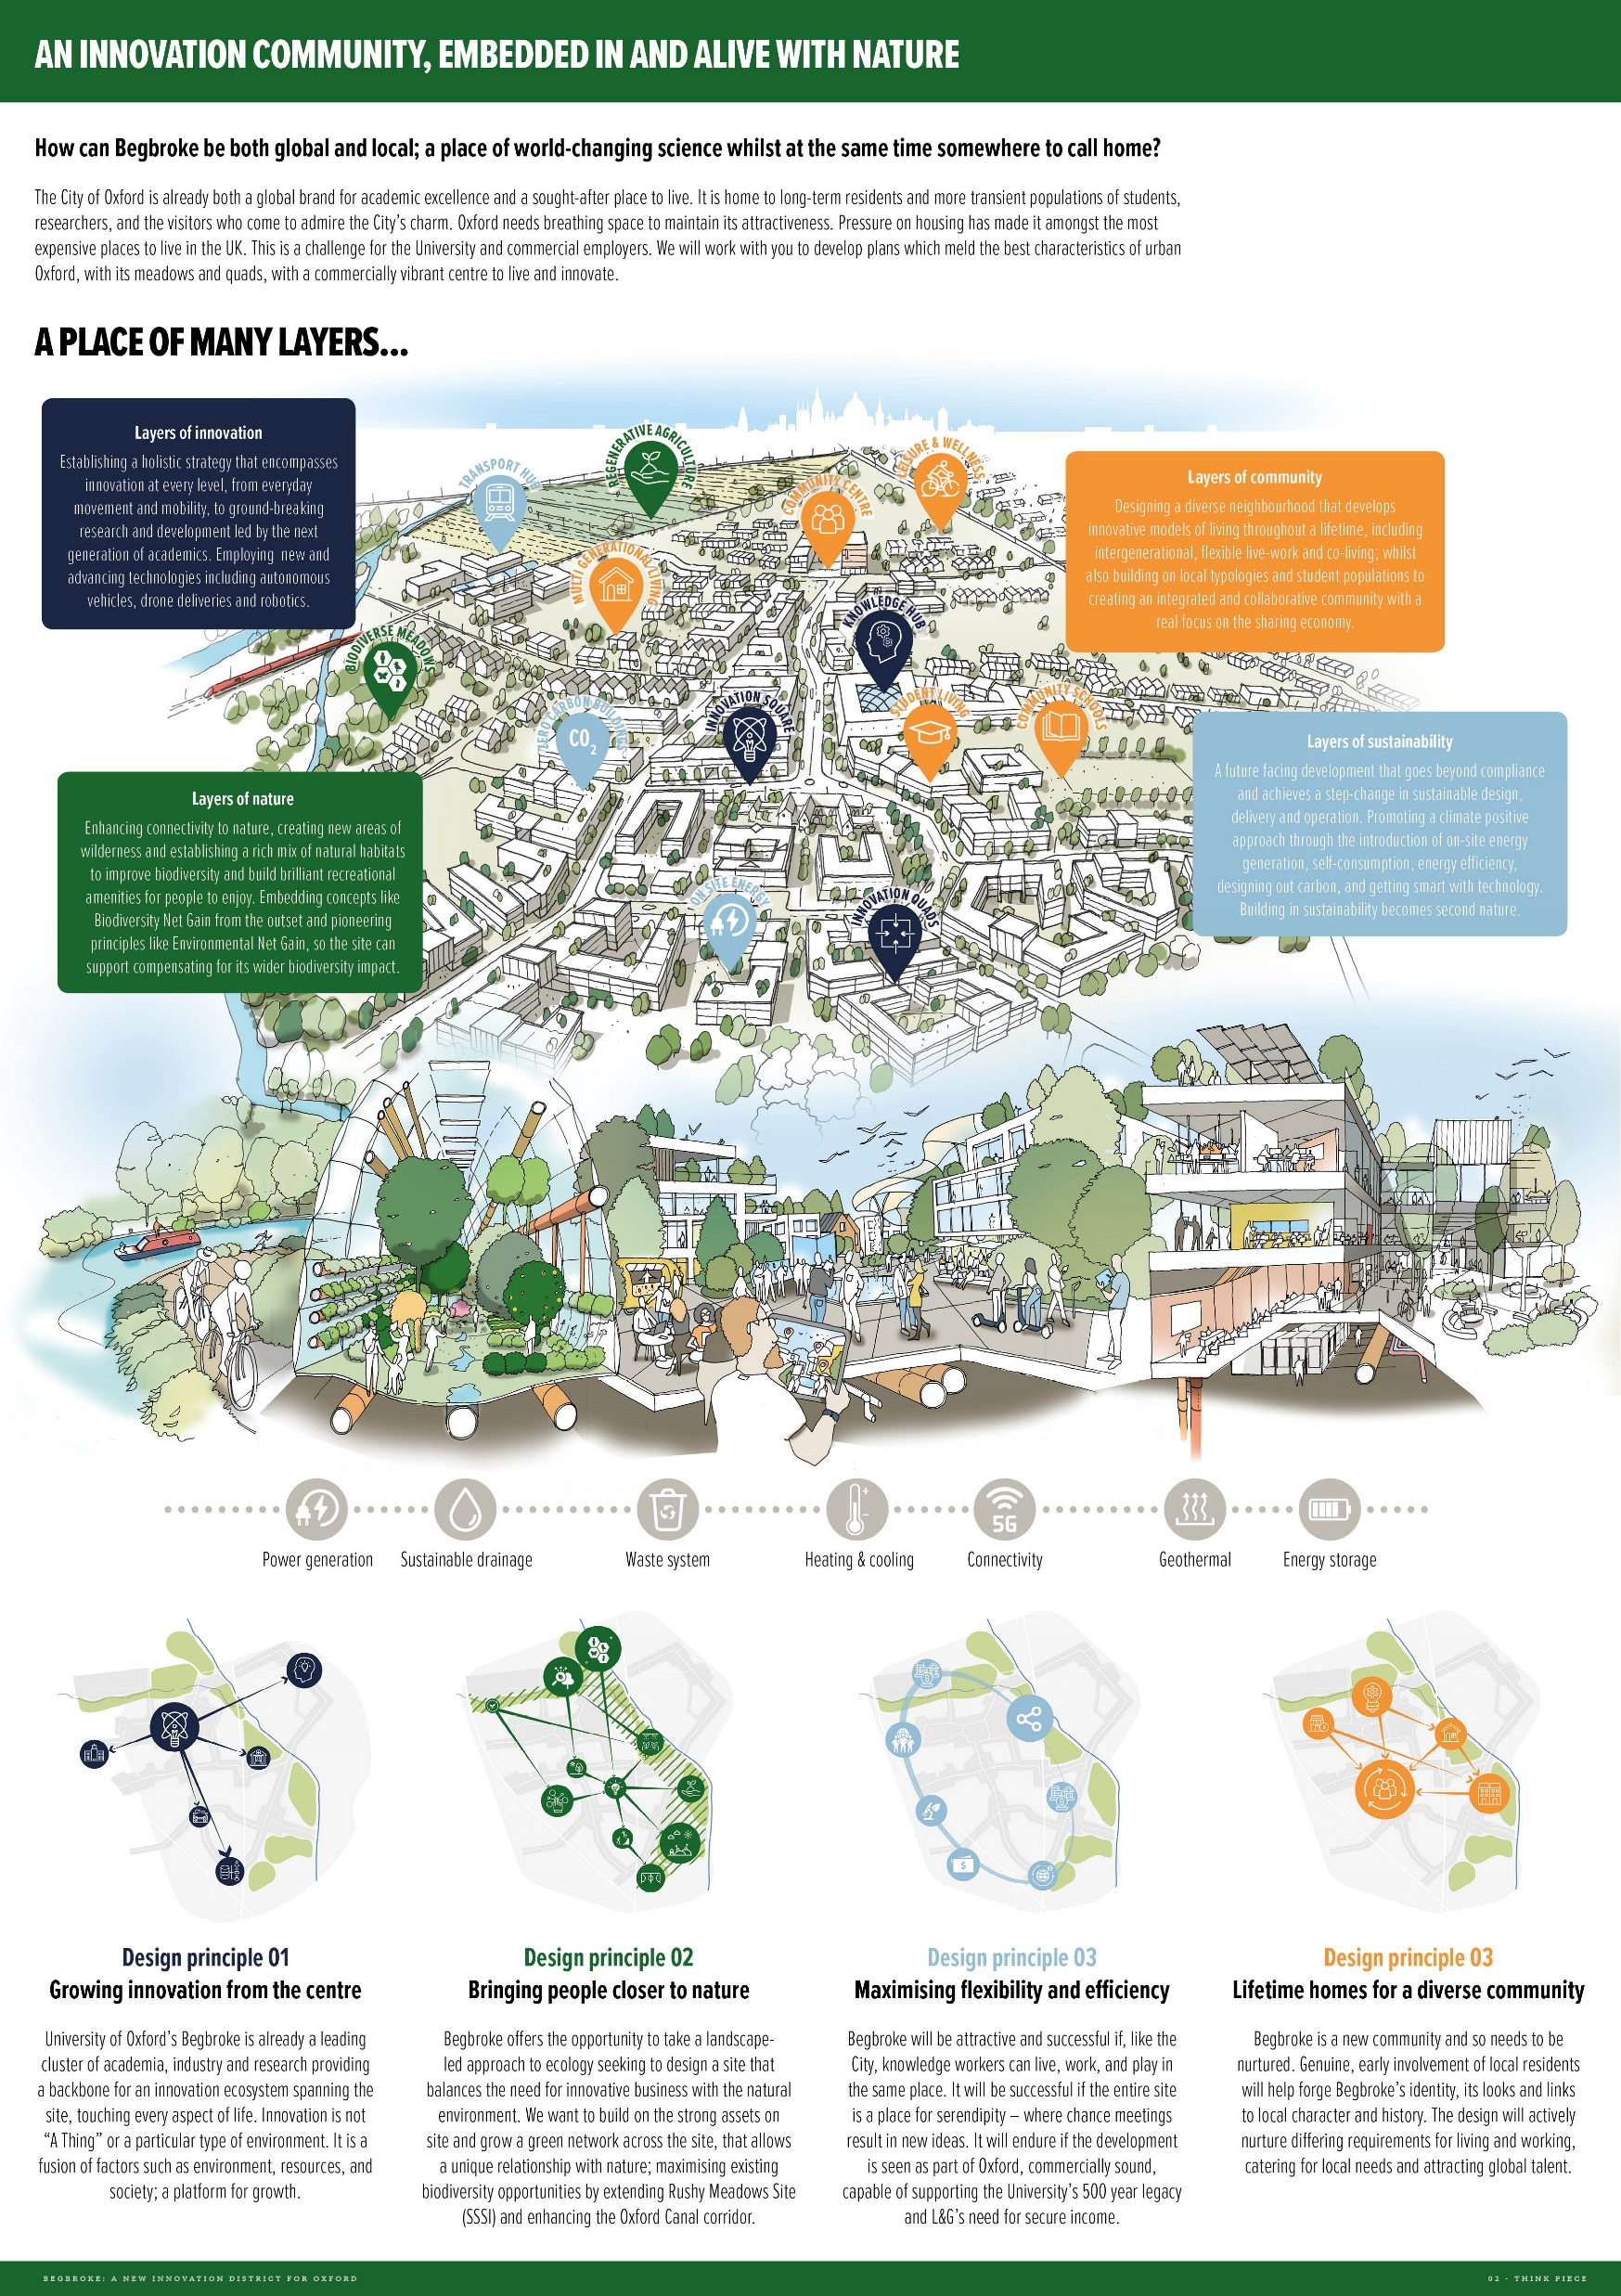

Slide 28
Glenn Howells Architects
Townshend Landscape Architects; Associated Architects (Oxford); AKTII;
WSP

Slide 29
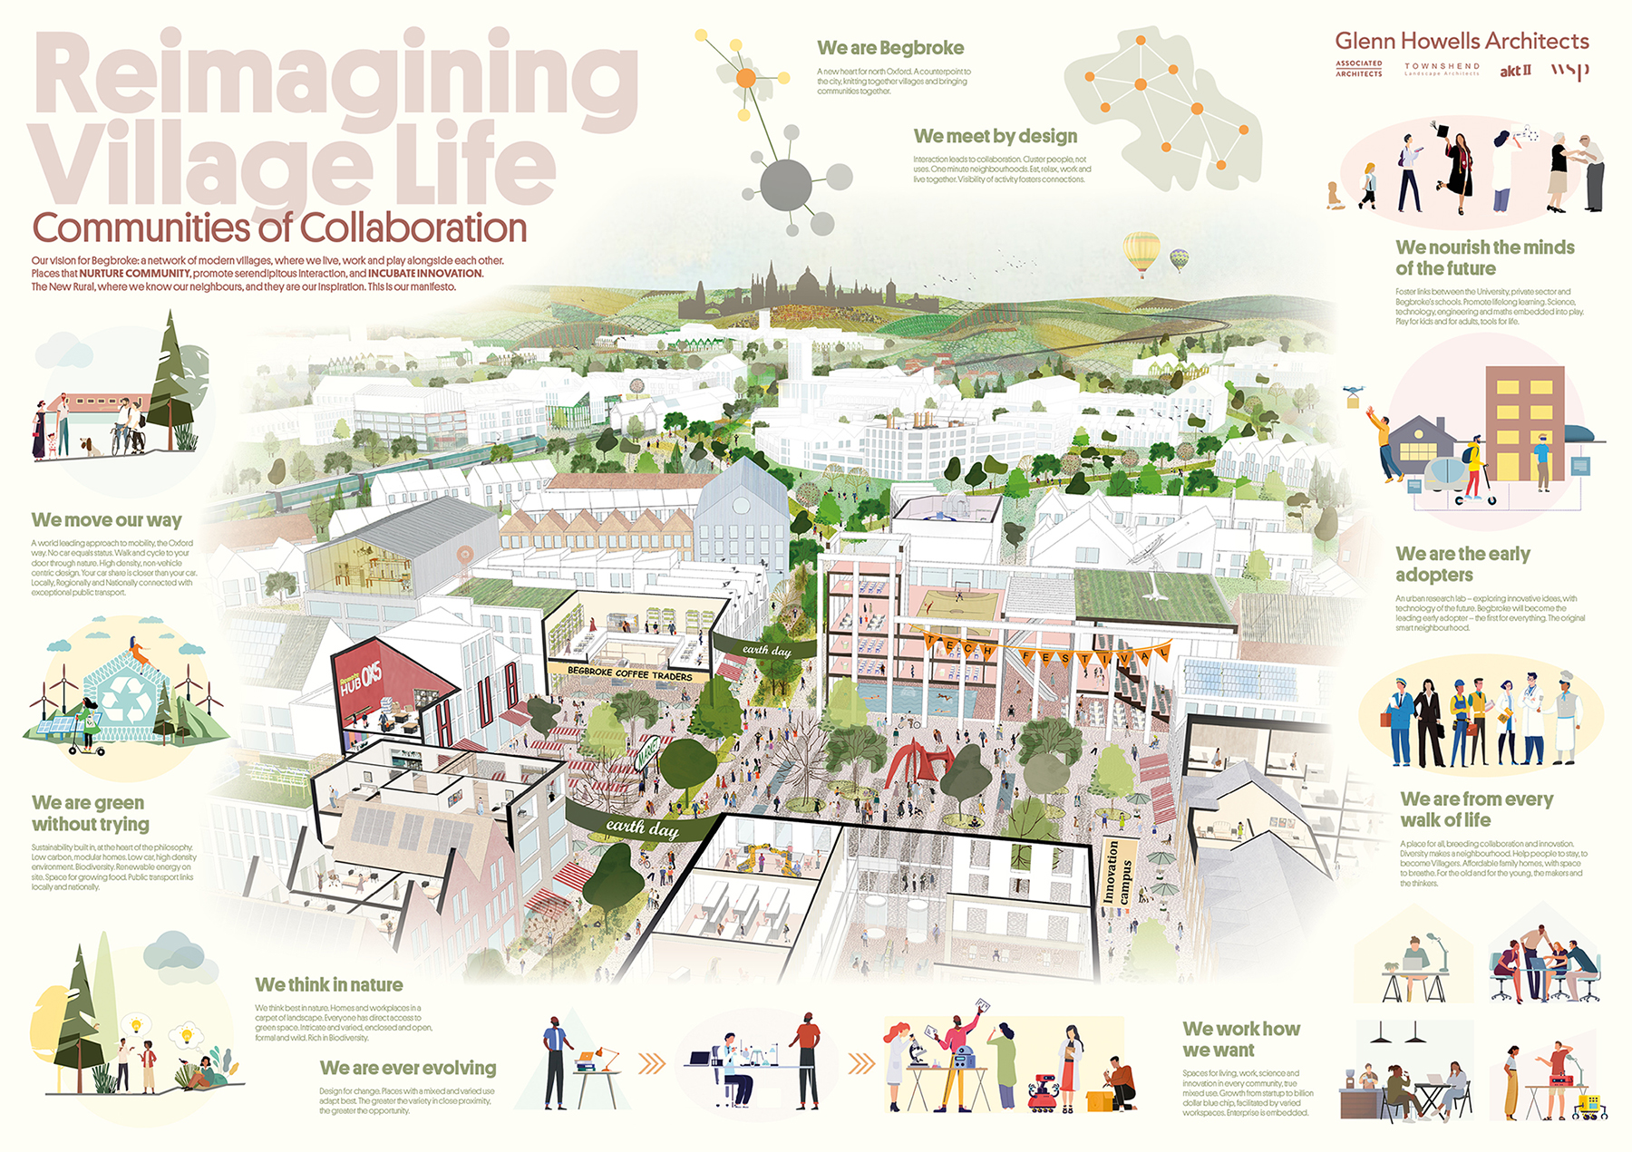

Slide 30
Grimshaw
Hoare Lea; BuroHappold; Logika Consultants; McGregor Coxall; Jas Bhalla Architects; Openstudio Architects; XCO2

Slide 31
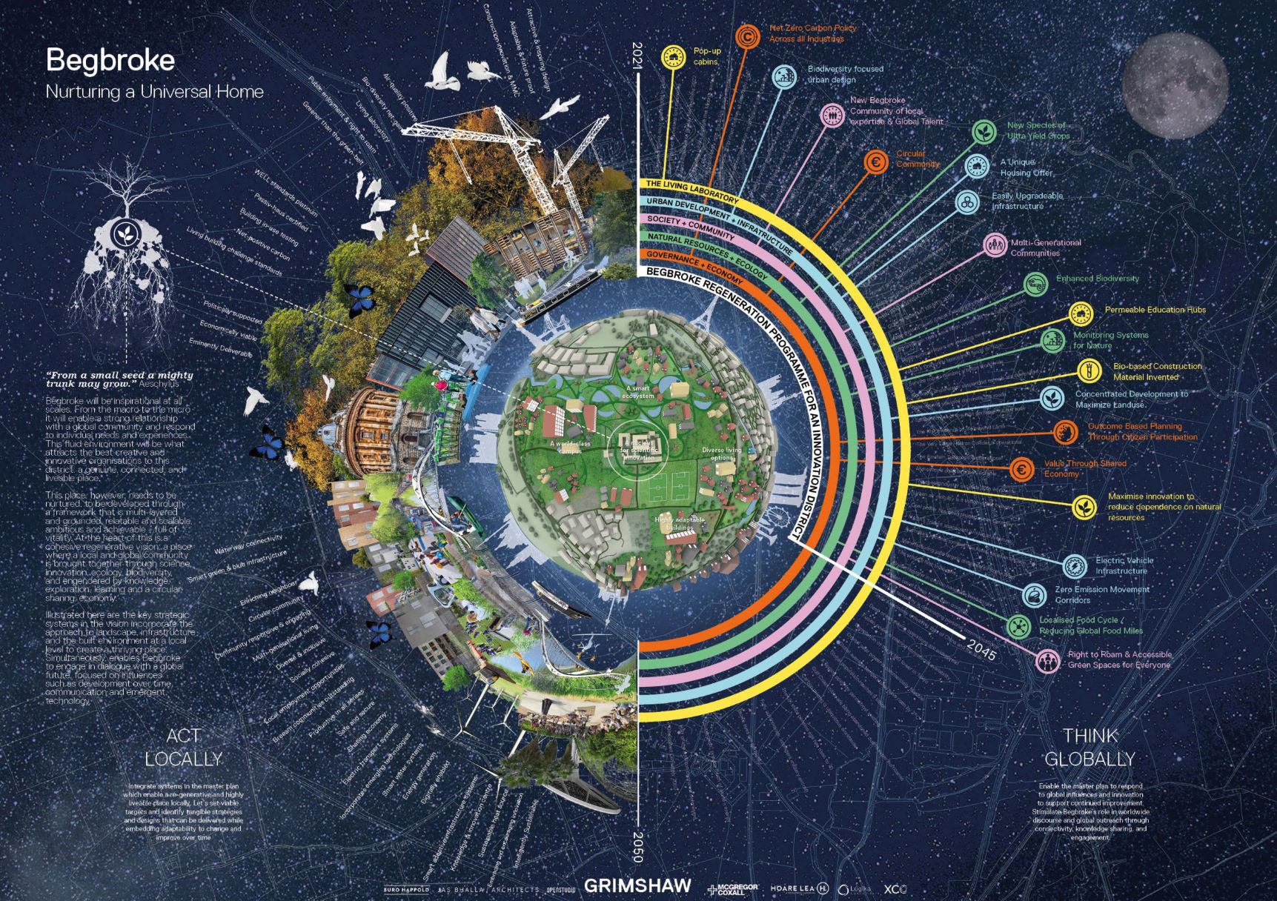

Slide 32
Hawkins Brown
OKRA (Netherlands); BuroHappold and C:Lab; RCKa; Ooze (Netherlands); Ecological Land Cooperative; Wordsearch Place

Slide 33
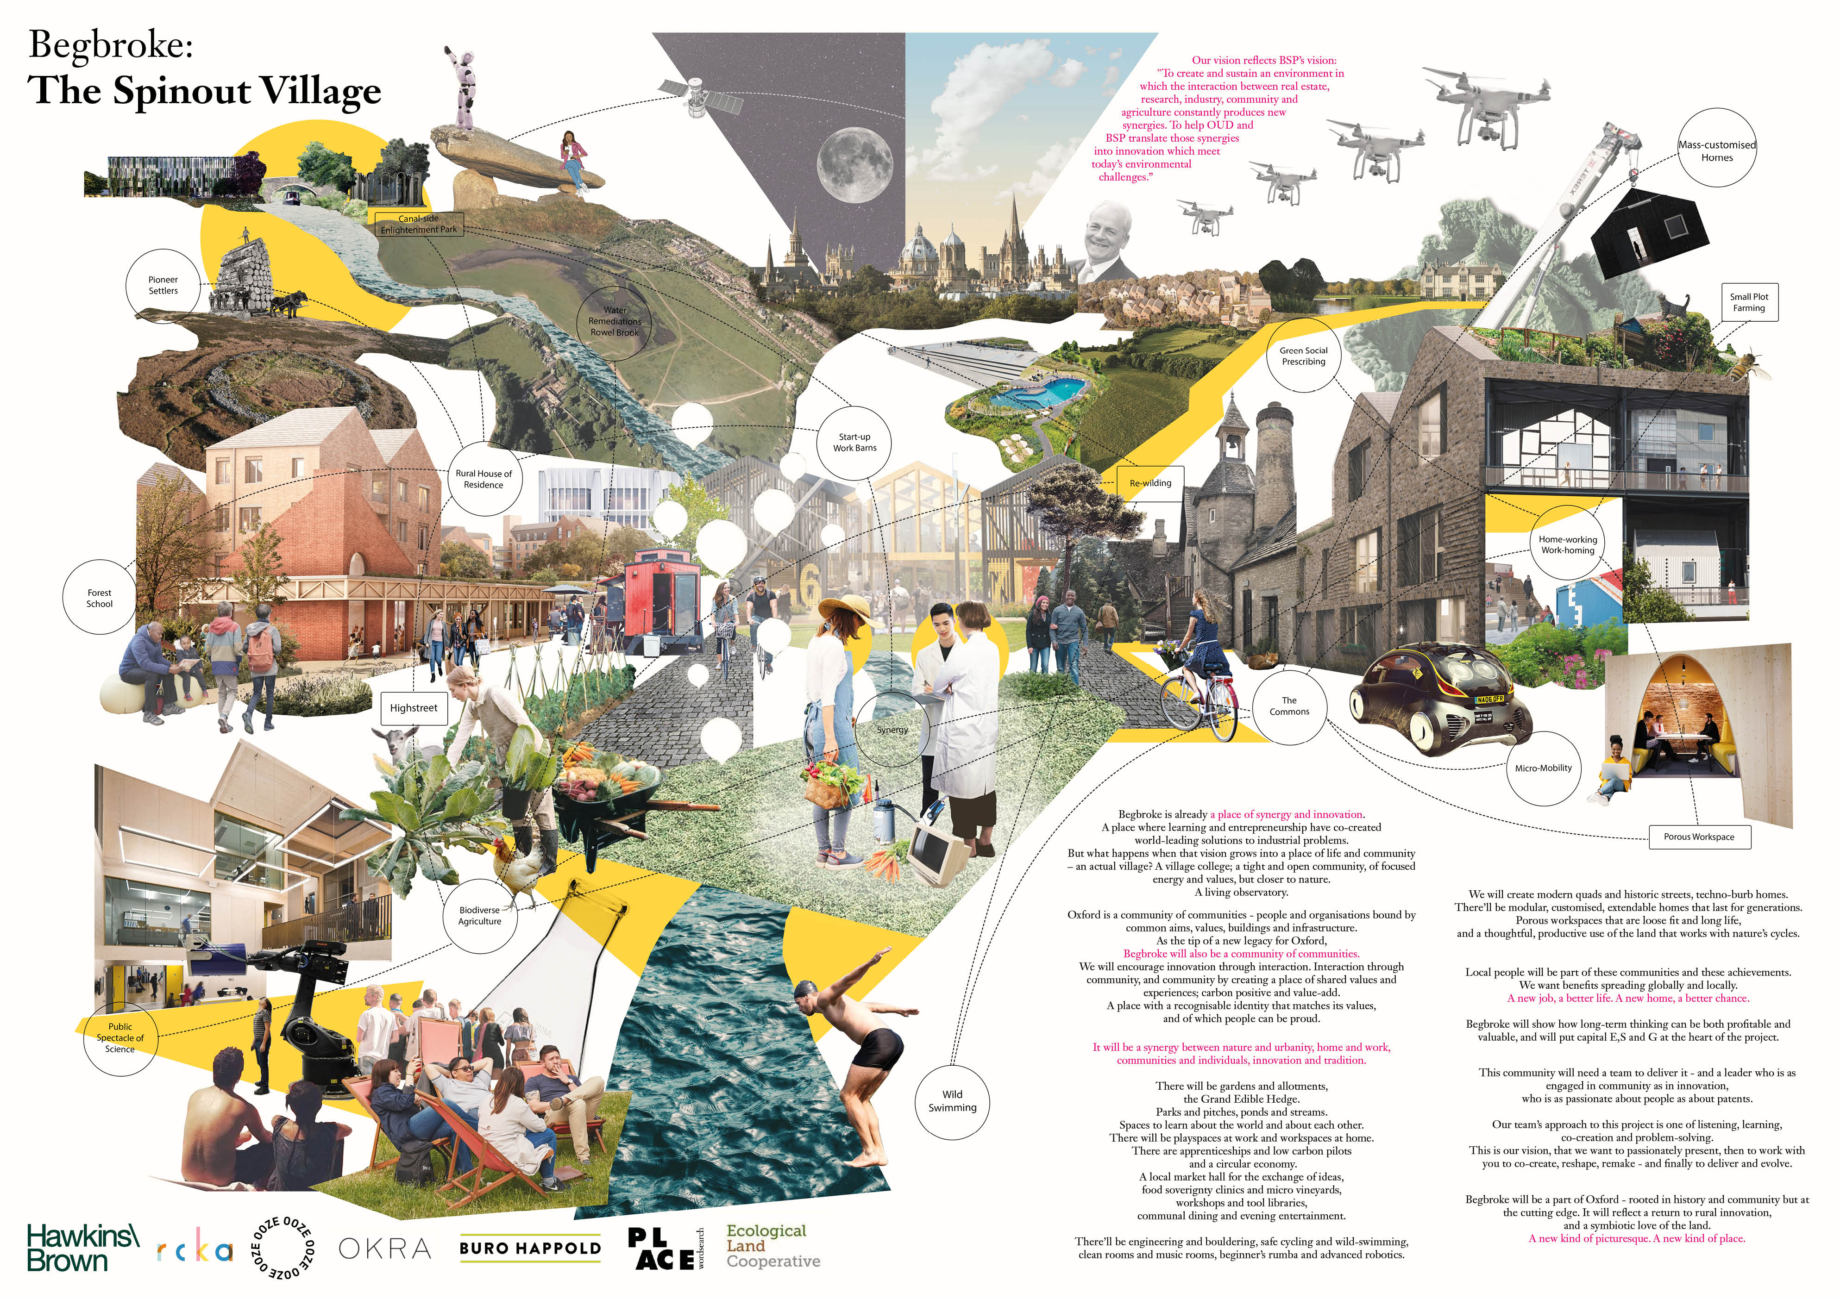

Slide 34
Henning Larsen
Morris+Company; West Port; Public Works; Rambøll Studio Dreiseitl
(Netherlands); BuroHappold

Slide 35
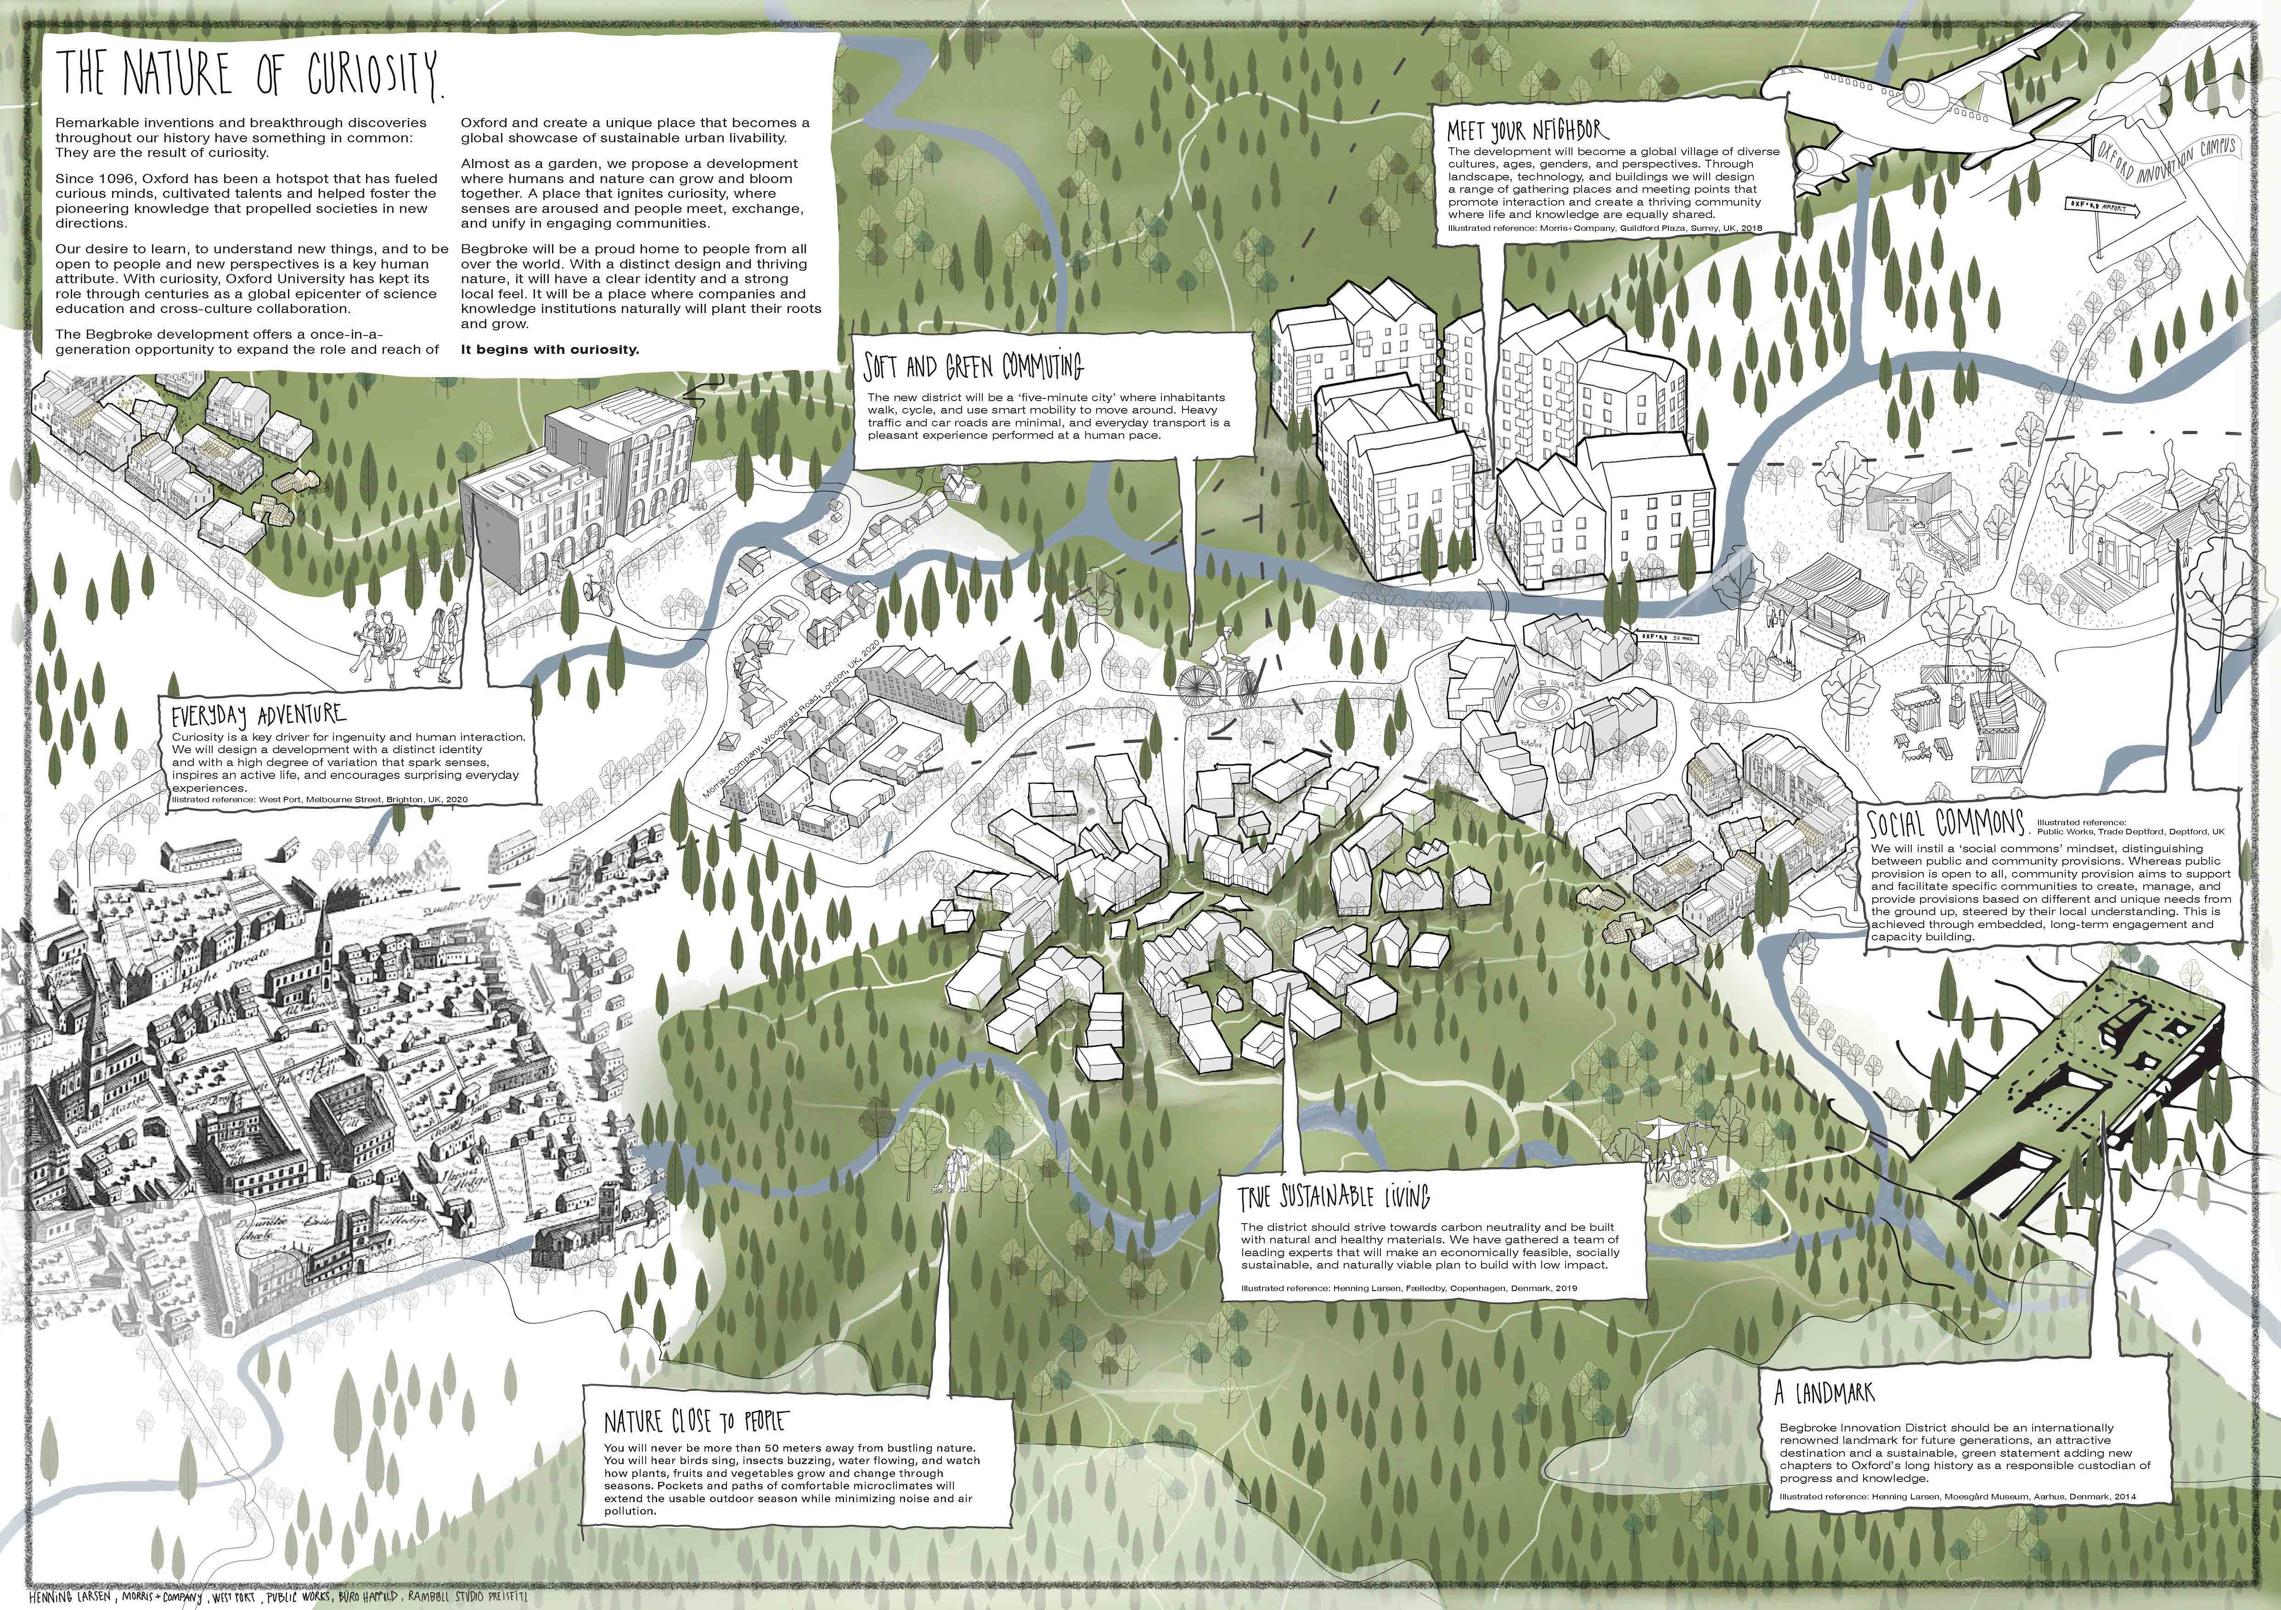

Slide 36
JCFO
Lichfields; vPPR Architects; WSP; Atelier Ten; Temple

Slide 37
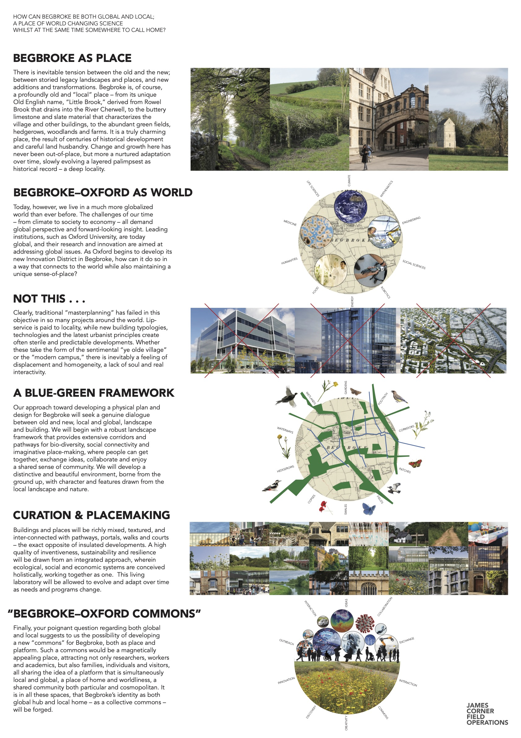

Slide 38
Jestico & Whiles
Townshend Landscape Architects; Hoare Lea; BuroHappold

Slide 39
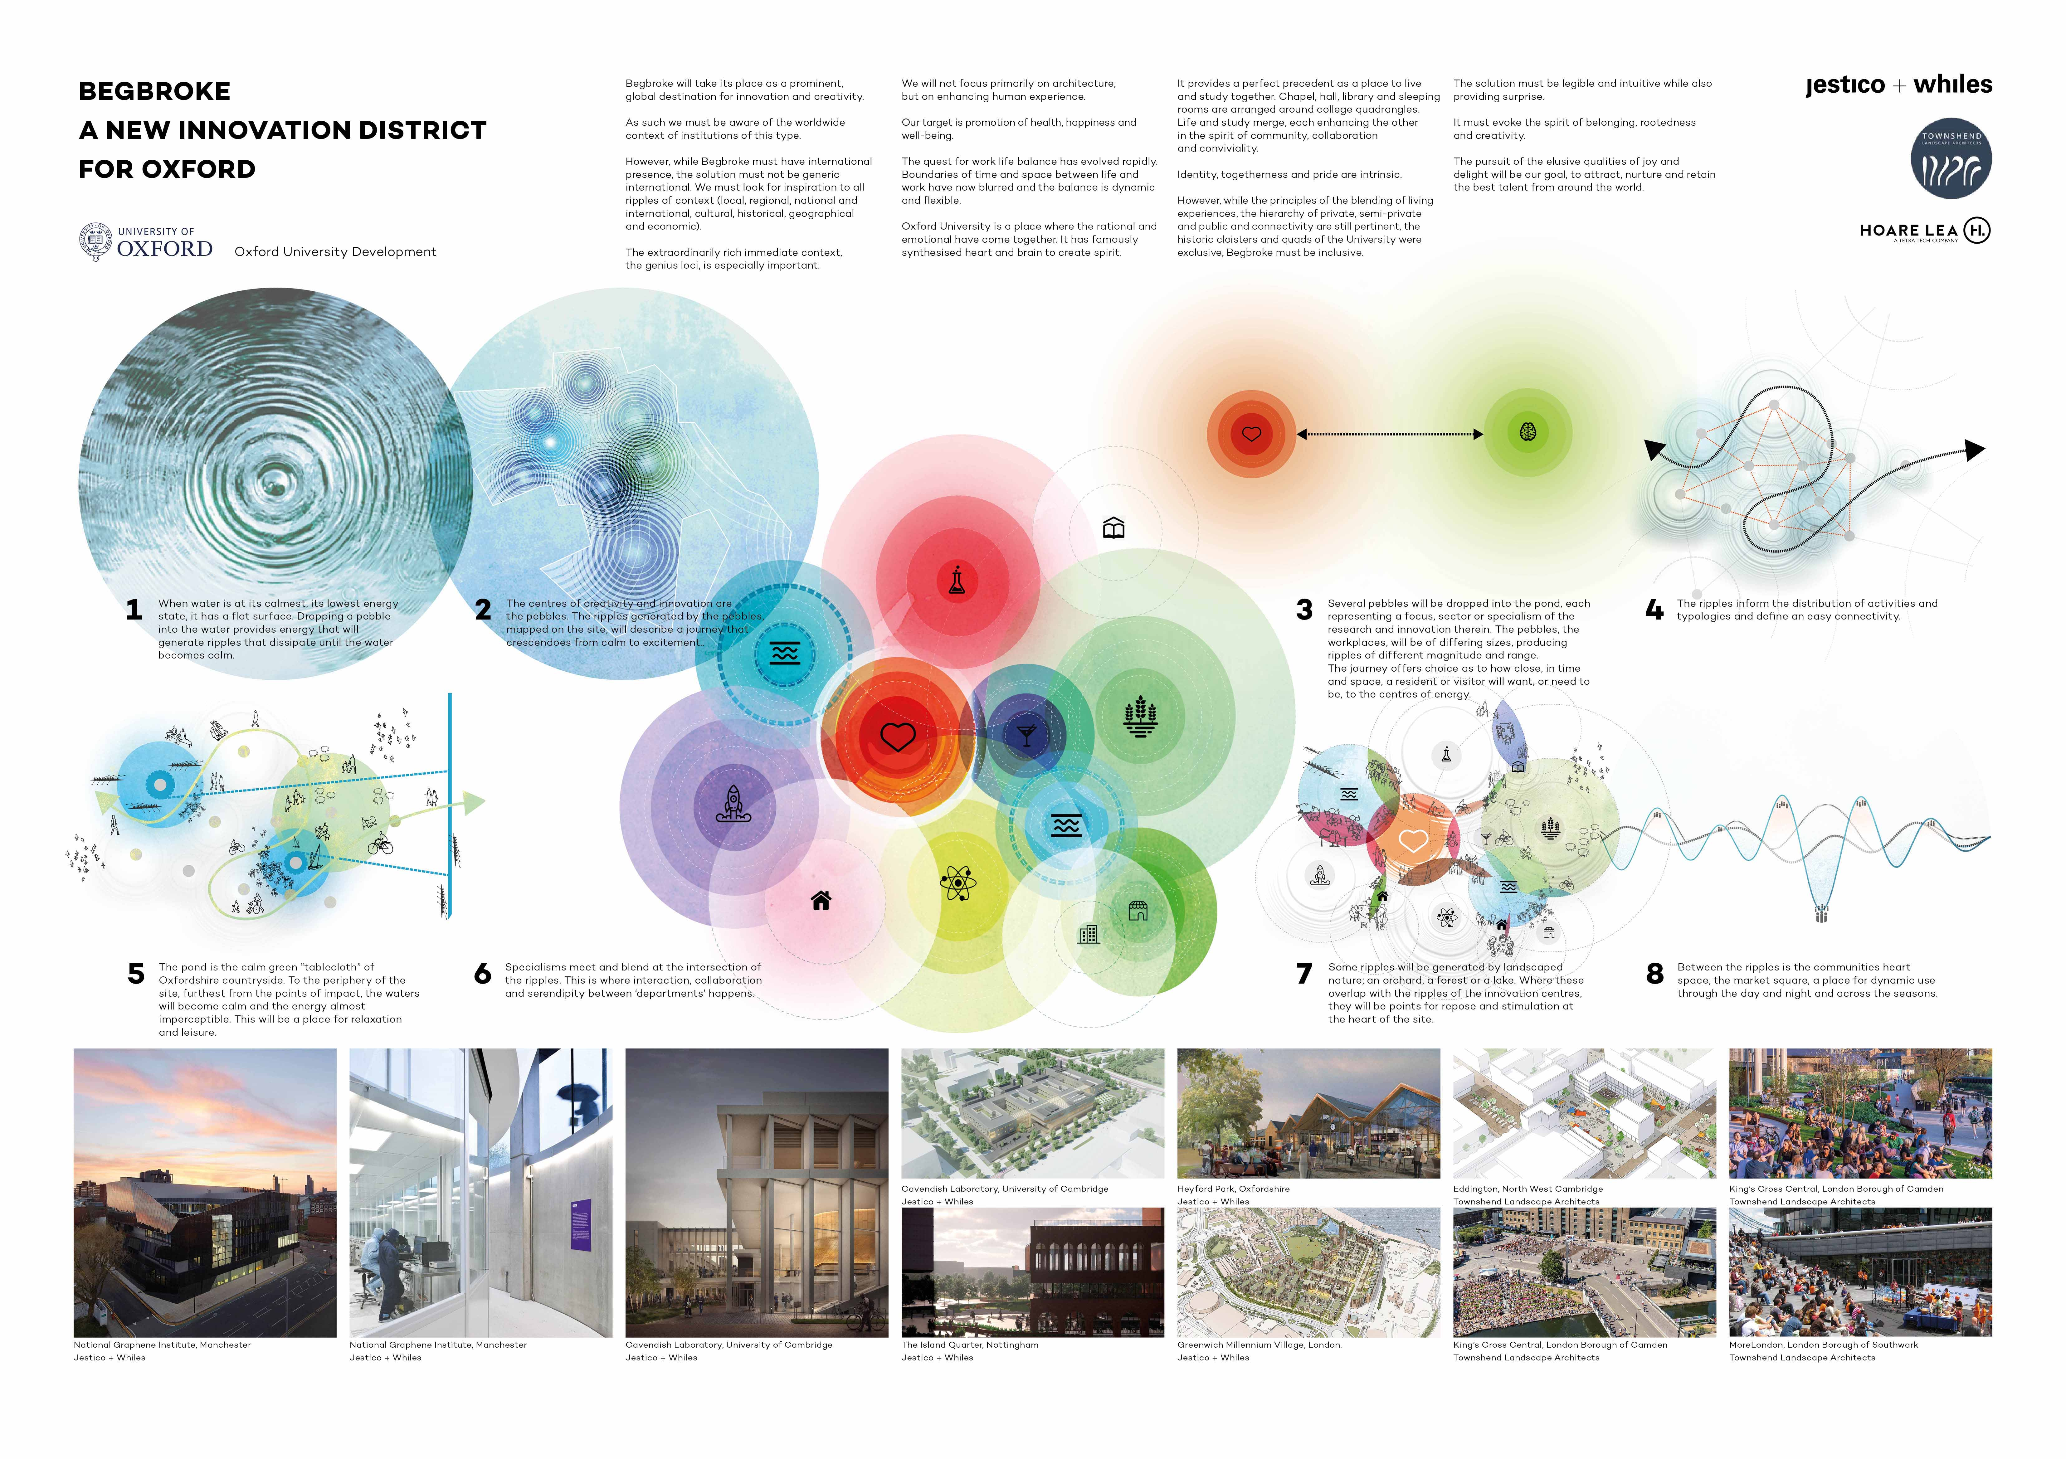

Slide 40
Jo Cowen Architects and
Pilbrow & Partners
Lord Matthew Taylor; West 8 (Netherlands); Atelier Ten; Vectos; Thornton Tomasetti; Arup; Expedition; Patrick Bellew; Space Syntax; Nigel Thompson

Slide 41
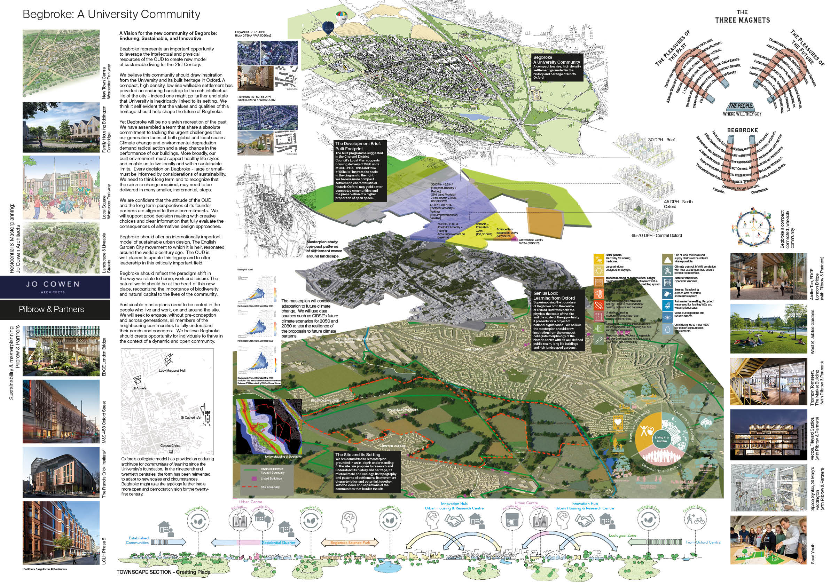

Slide 42
John McAslan & Partners
MVRDV (Netherlands); Gillespies (Oxford); Arup; Mace; Savills; DP9; Pimm Studio; Pocket Living; Studio Boeri (Italy); Tate + Co; RCKa; Mole
Architects; Threefold Architects; Roz Barr; Dow Jones Architects; Tikari
Works; FJMT (Oxford); Perkins & Will; Peris and Toral (Spain); Collective
Architecture

Slide 43
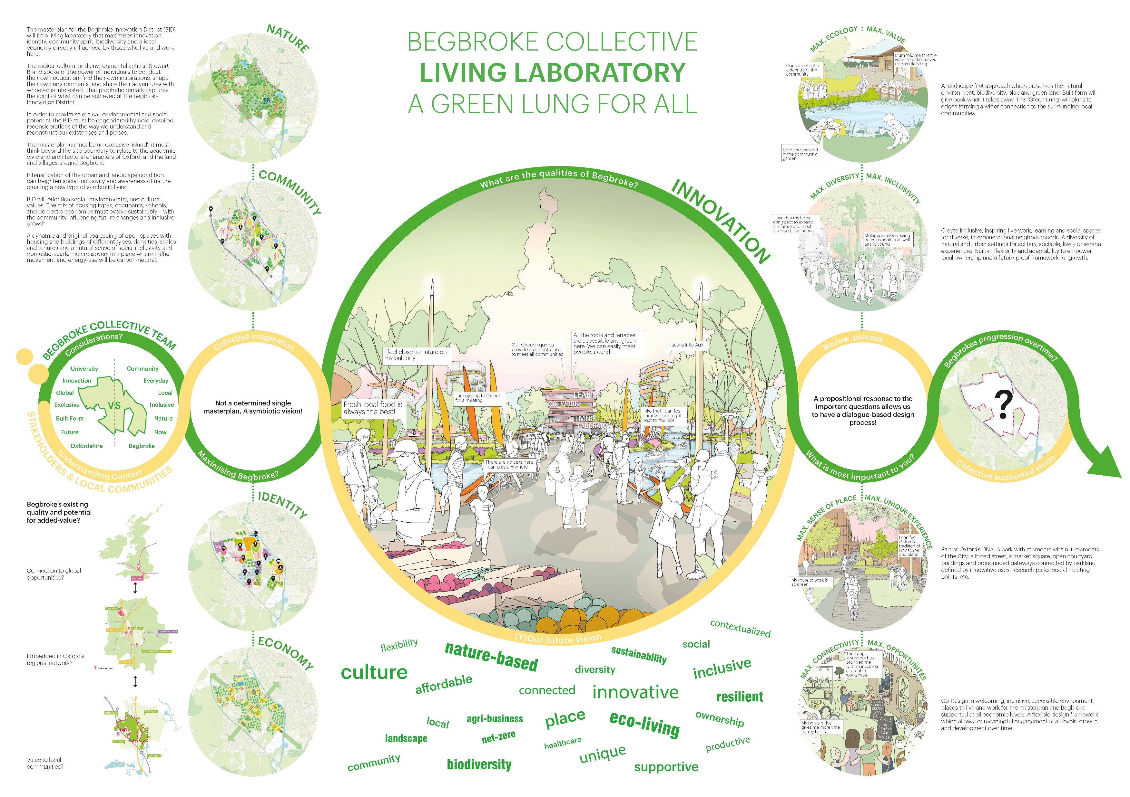

Slide 44
KPF
Publica; Andy Sturgeon Design; Bell Phillips; AKT II; Buro Happold;
Momentum Transport Consultancy

Slide 45
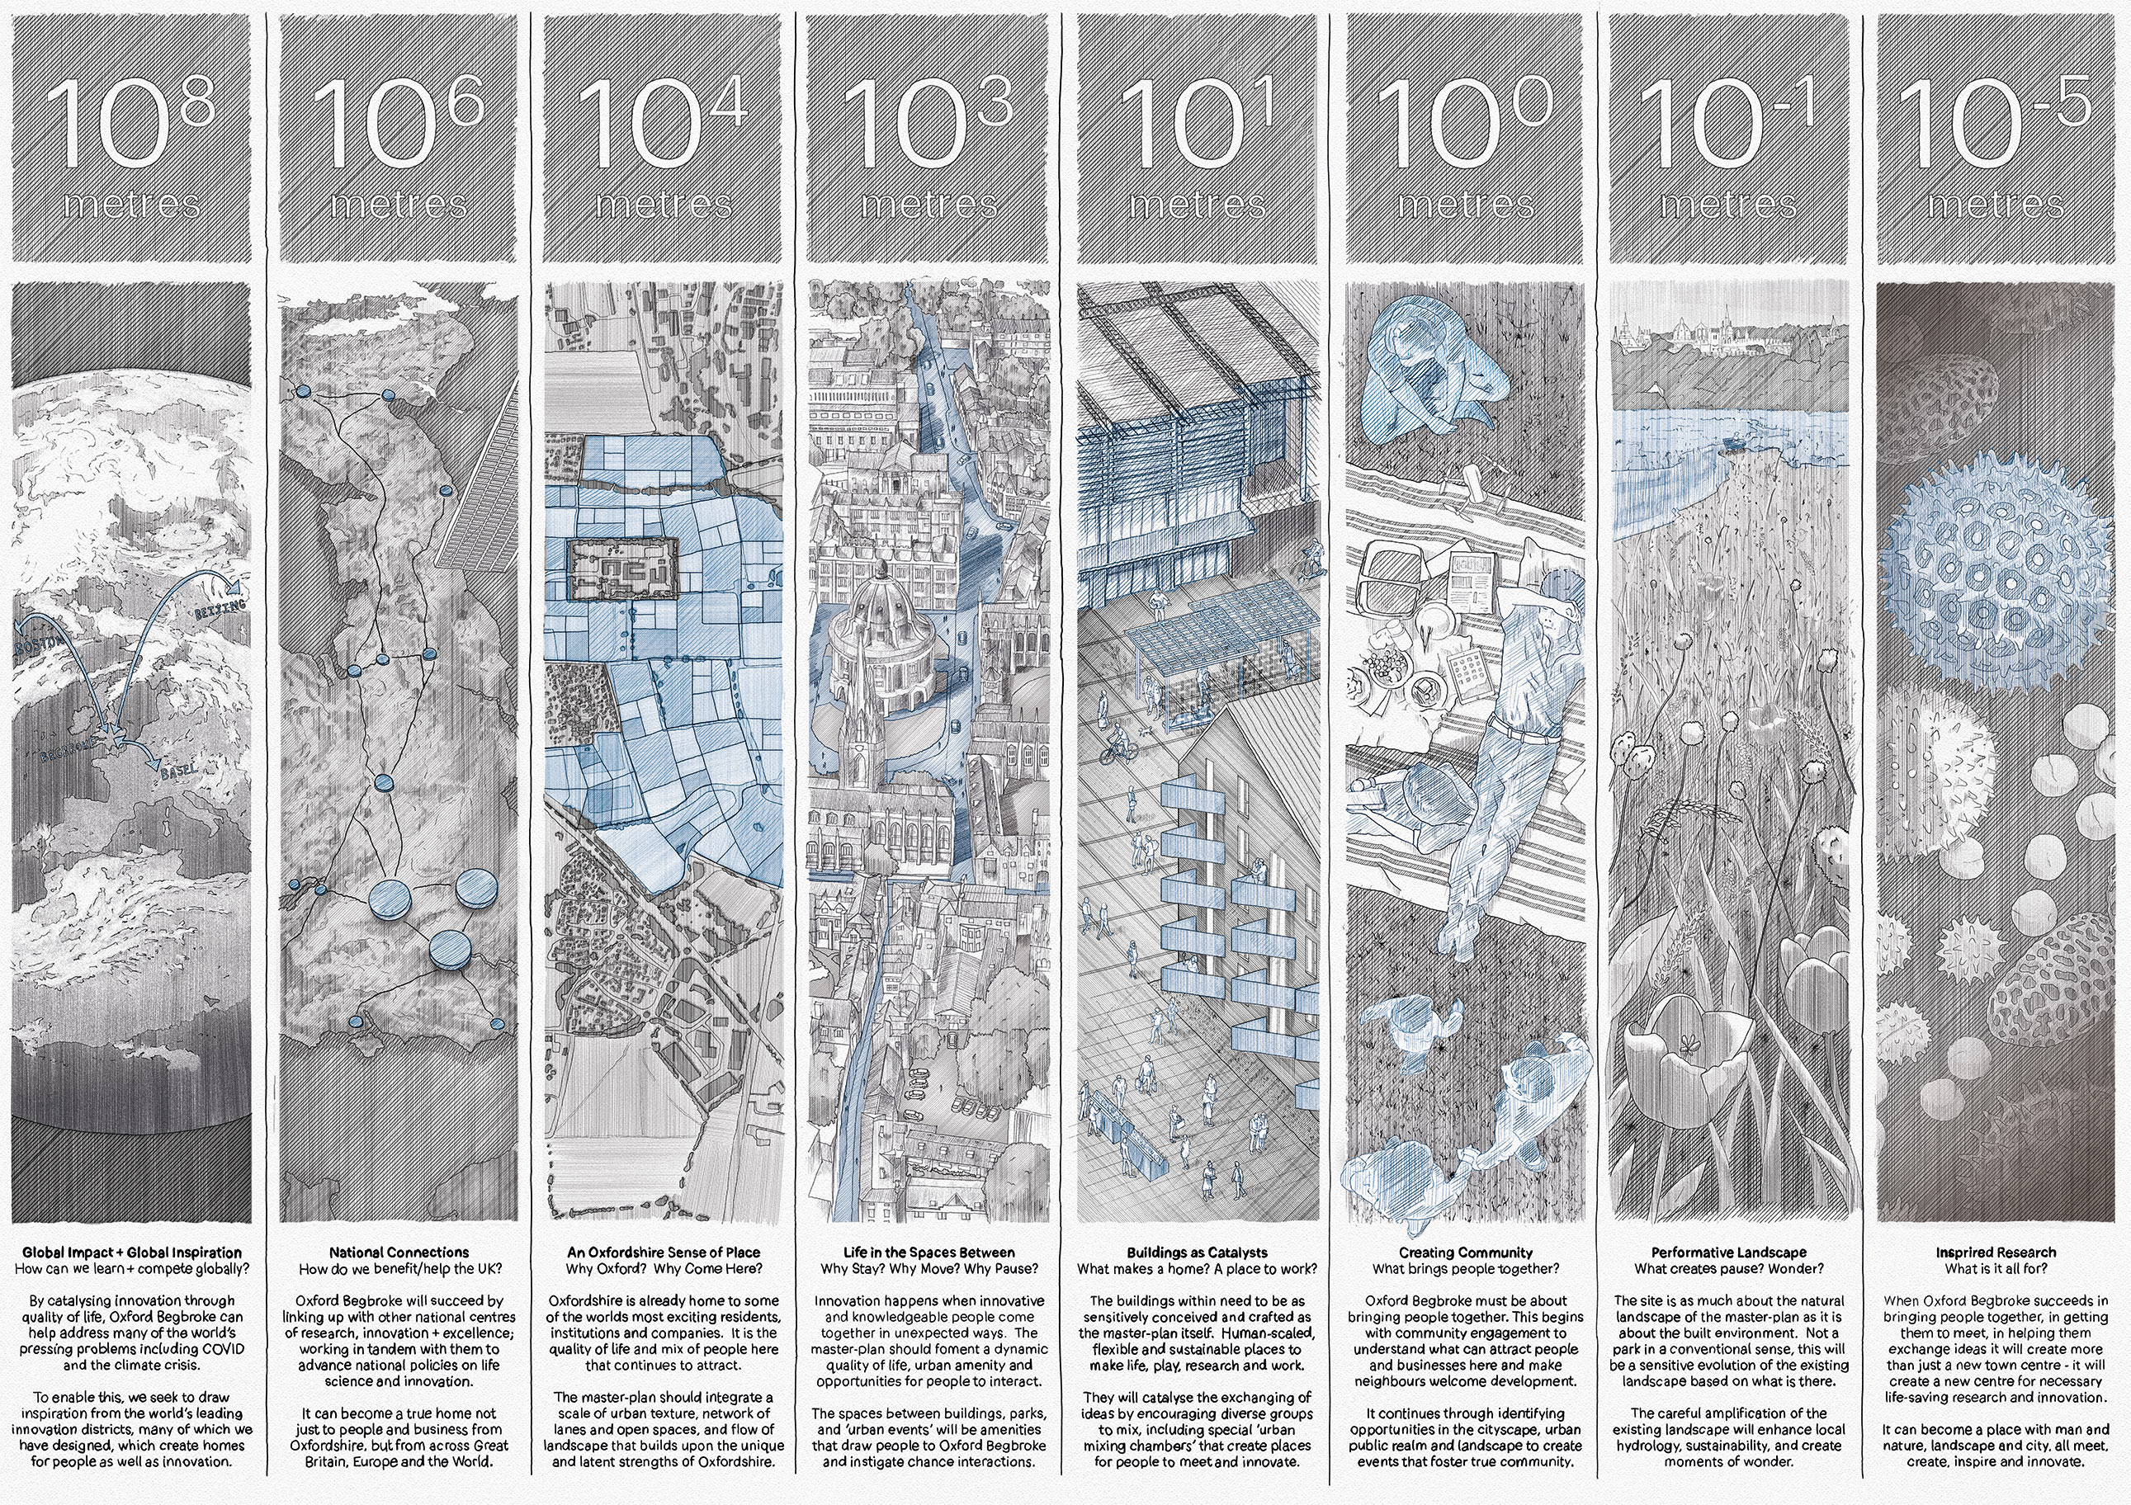

Slide 46
Levitt Bernstein
LDA Design; Stanton Williams; MICA; Knight Architects; Buro Happold;
Arup; Mark Hodgson; Freehaus; Fusion Arts

Slide 47
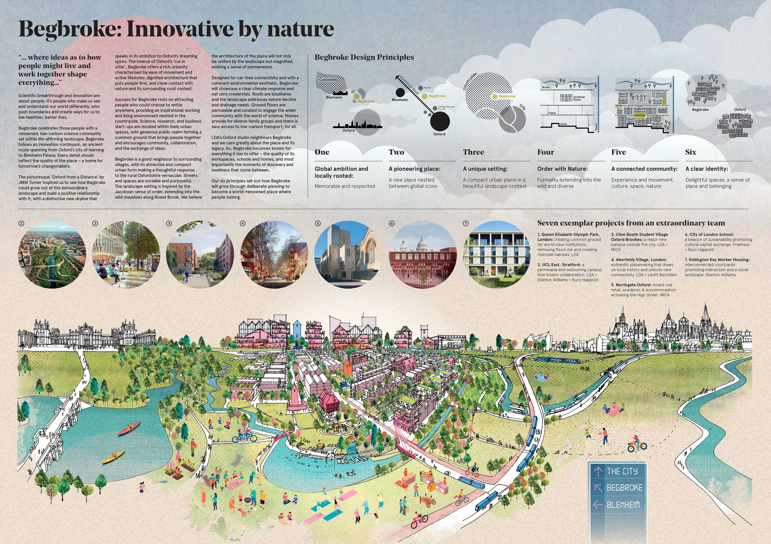

Slide 48
Maccreanor Lavington
Haworth Tompkins; Herzog & de Meuron (Switzerland); Churchman
Thornhill Finch; Useful Projects; Innovation First; HETA; Civic Engineers;
Max Fordham

Slide 49
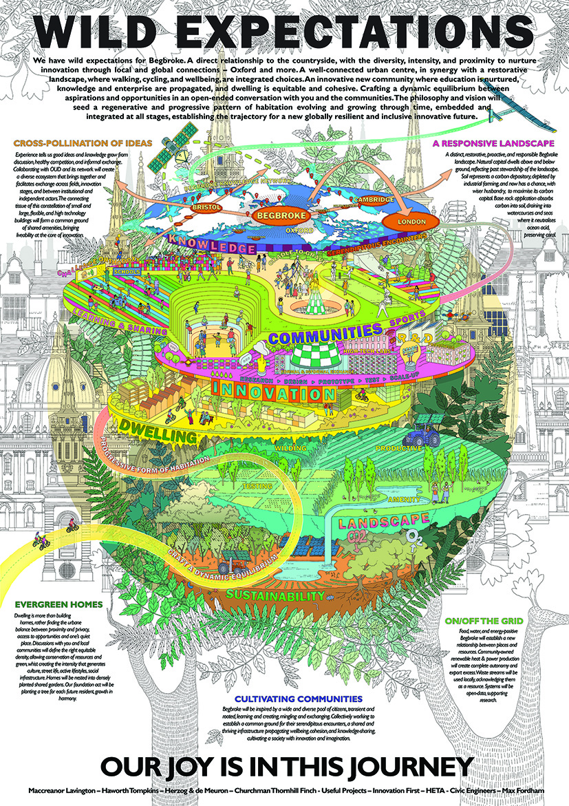

Slide 50
Metropolitan Workshop
Sarah Wigglesworth Architects; Studio Partington; ZCD Architects; Land
Use Consultants; AECOM; Elements; Cam-Sci; Centre for Housing Policy-York University

Slide 51
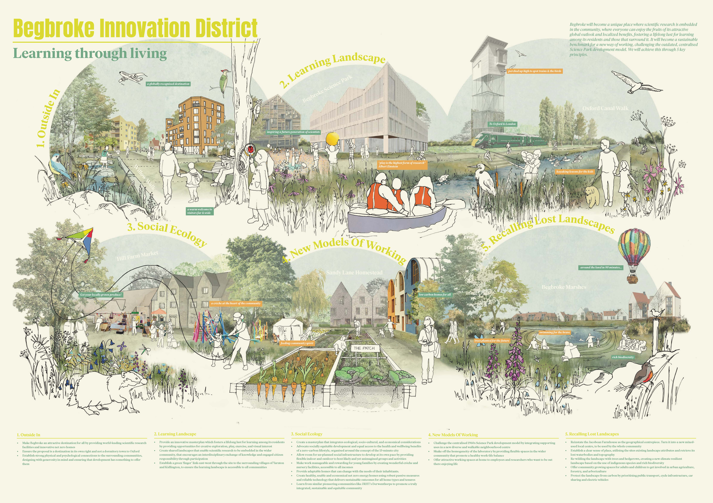

Slide 52
OMA
Buro Happold; Planit I.E.; Shed K.M.; Groupwork; Webb Yates; PFB
Construction Management Services. Advisors: Theatrum Mundi; John
Lotspeich; Gustavo Sbardelotto

Slide 53
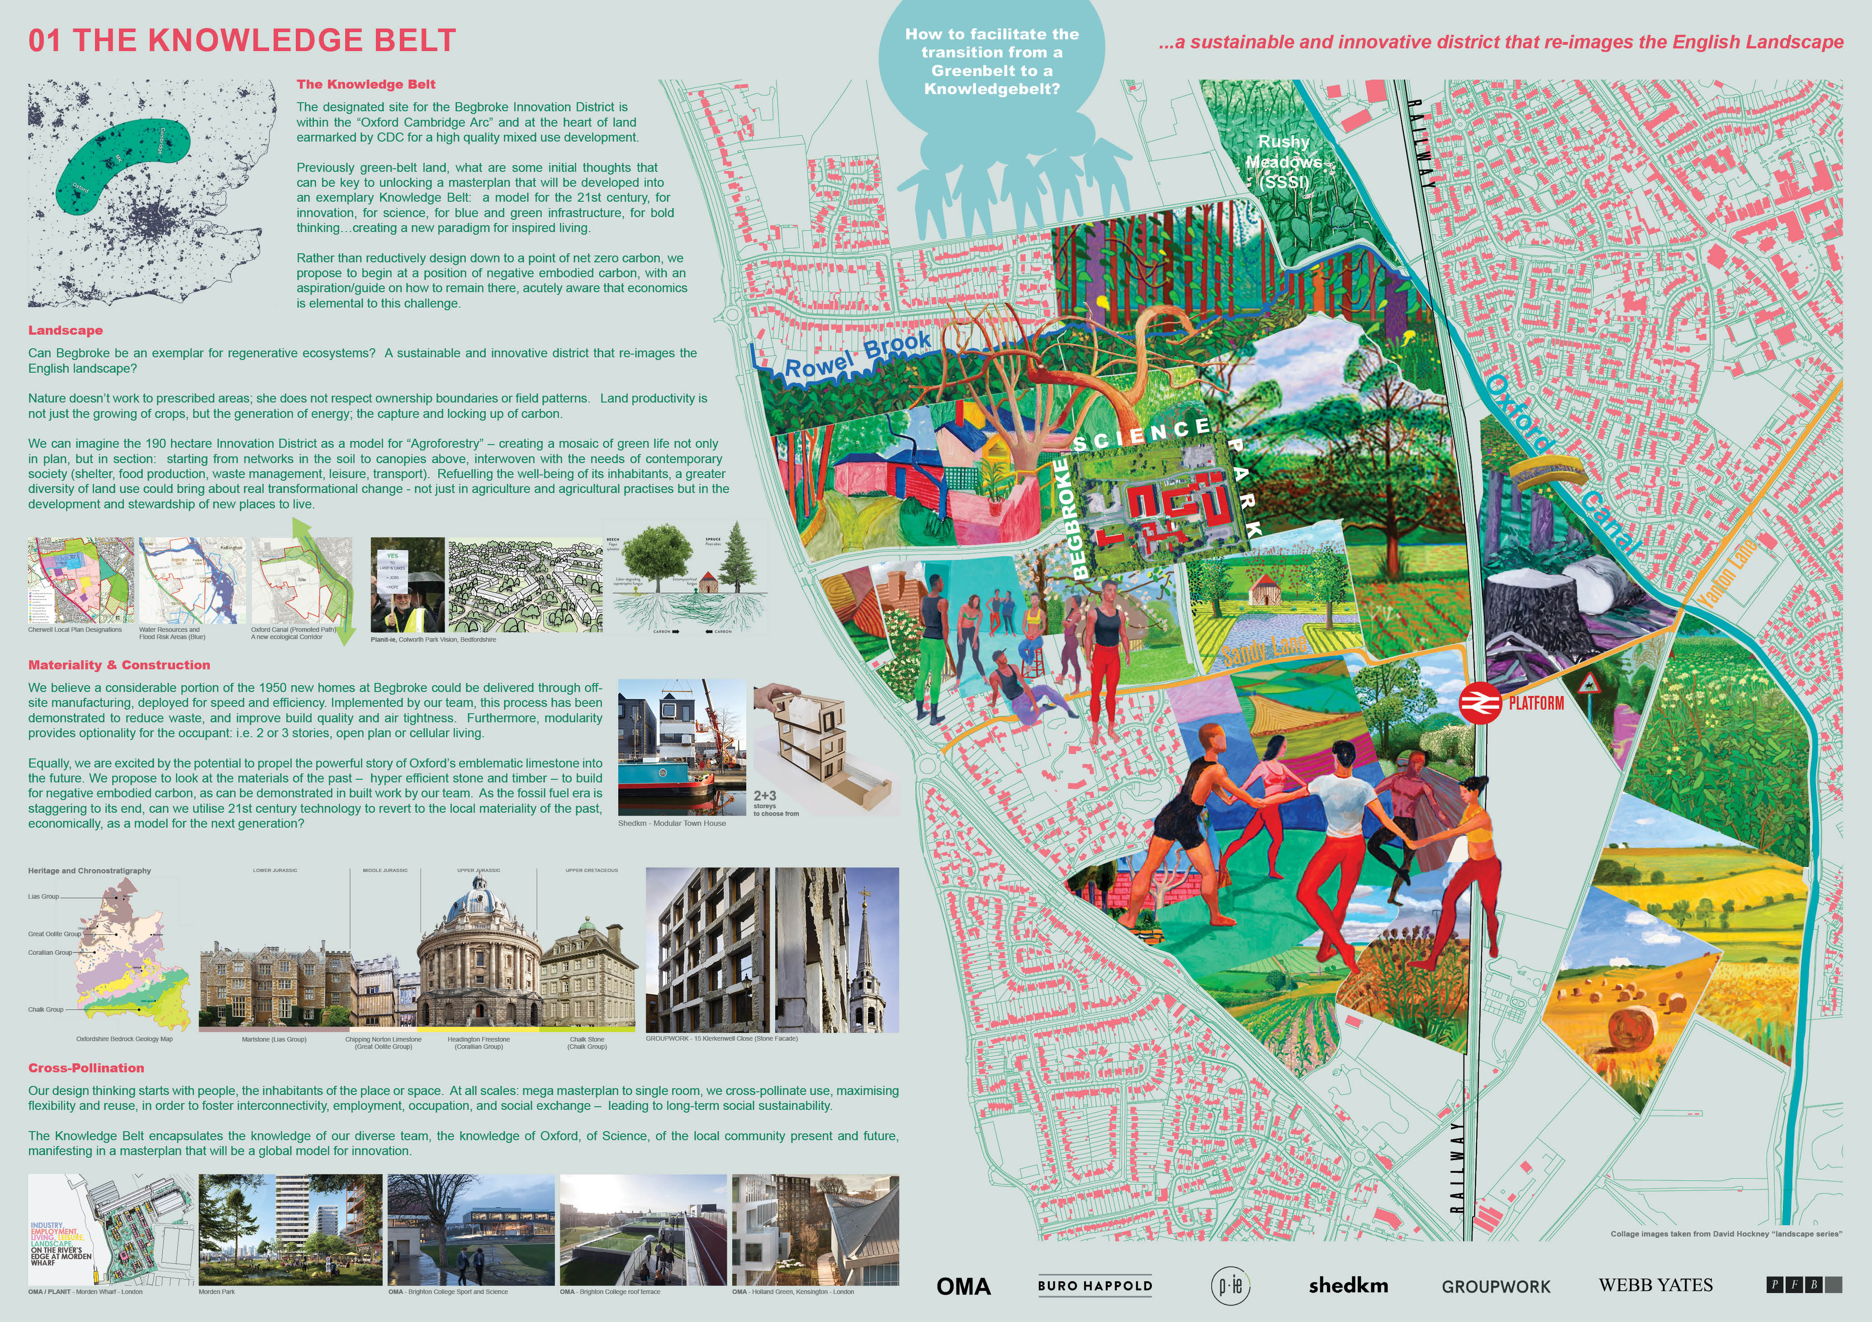

Slide 54
Paul Sauthouse Architects
Mike Habermehl; Dr Euan McTurk

Slide 55
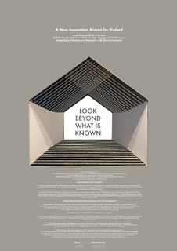

Slide 56
Periscope
Kjellander Sjöberg (Sweden); Henley Halebrown; Fisher Cheng; Al-Jawad Pike; Ian Firth; WSP;Urban Nature

Slide 57
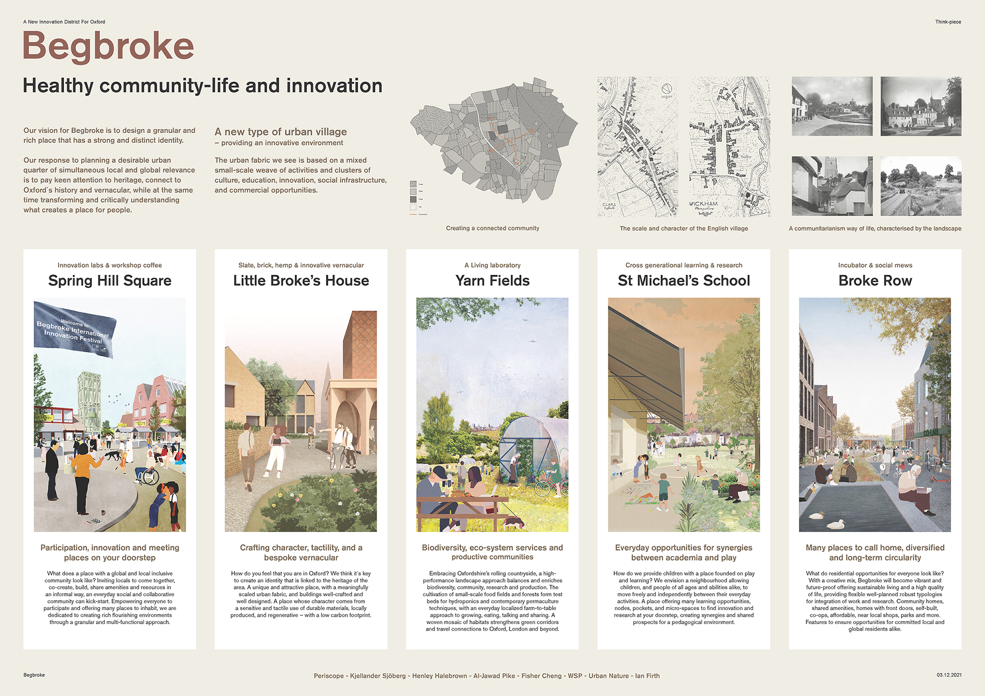

Slide 58
Prior + Partners
The Place Bureau; Alison Brooks Architects; Wilkinson Eyre Architects;
dRMM; Gilespies (Oxford); Spacehub; Ramboll; Stantec; Hoare Lea; Keith Orlesky; Philipp Bouteiller; Pooran Desai; Transition by Design (Oxford); Transsolar (Germany); Usman Haque; Jonathan Rose Companies (USA)

Slide 59
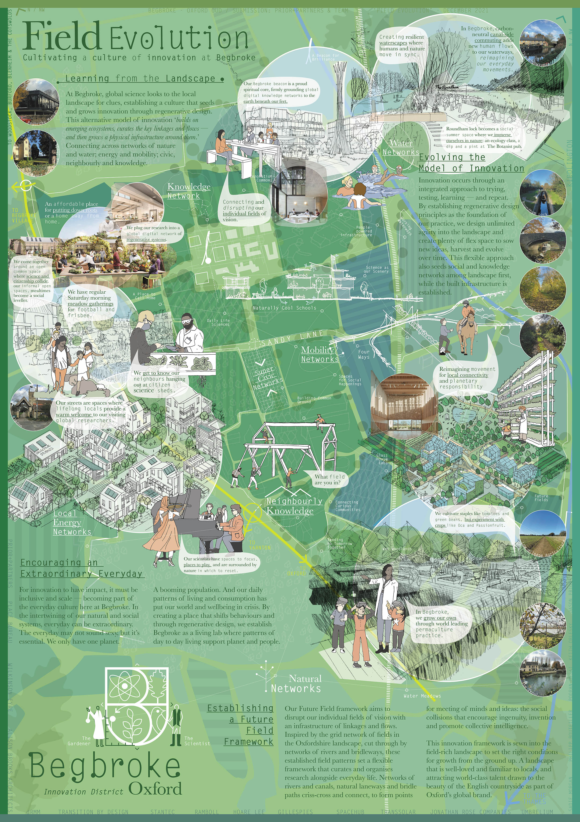

Slide 60
Proctor Matthews
Stephen Willacy Architecture + Urbanism (Denmark); O'Donnell & Toumey (Ireland); LOOP (Denmark); Townshend Landscape Architects; Arup; Phil Jones Associates; Max Fordham, Keegans

Slide 61
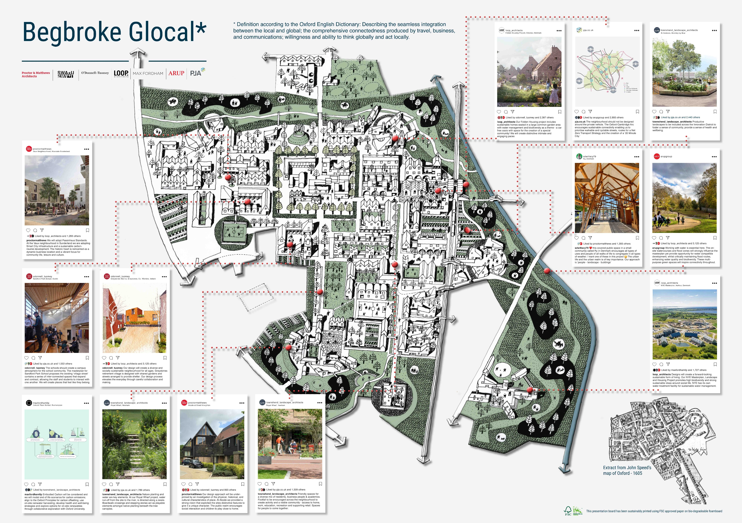

Slide 62
Ryder
Hydrock; Fira Landscape Architects; MosArt (Ireland)

Slide 63
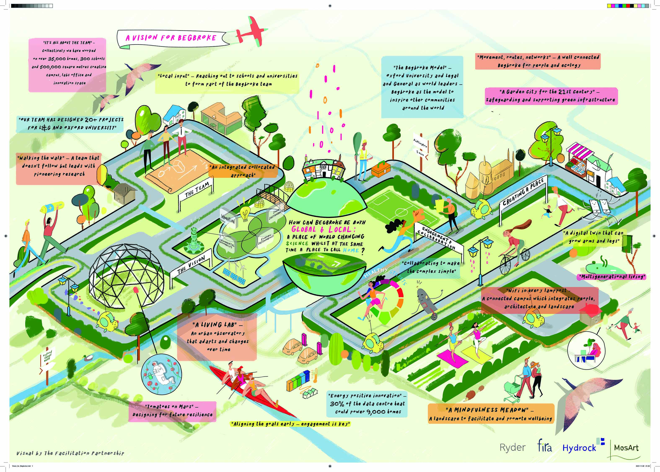

Slide 64
Scott Brownrigg
Ramboll; Hoare Lea; Macfarlane Associates

Slide 65
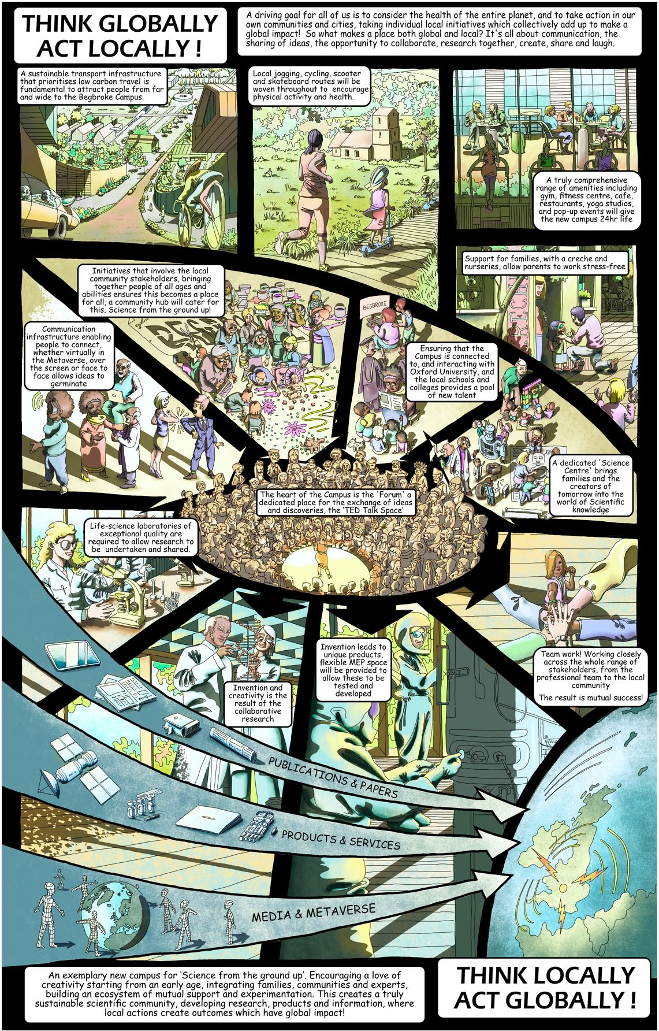

Slide 66
Shepheard Epstein Hunter
Ramboll; Townshend Landscape Architects; Adrian James Architects
(Oxford); Denizen Works; DUP; Urban Silence

Slide 67
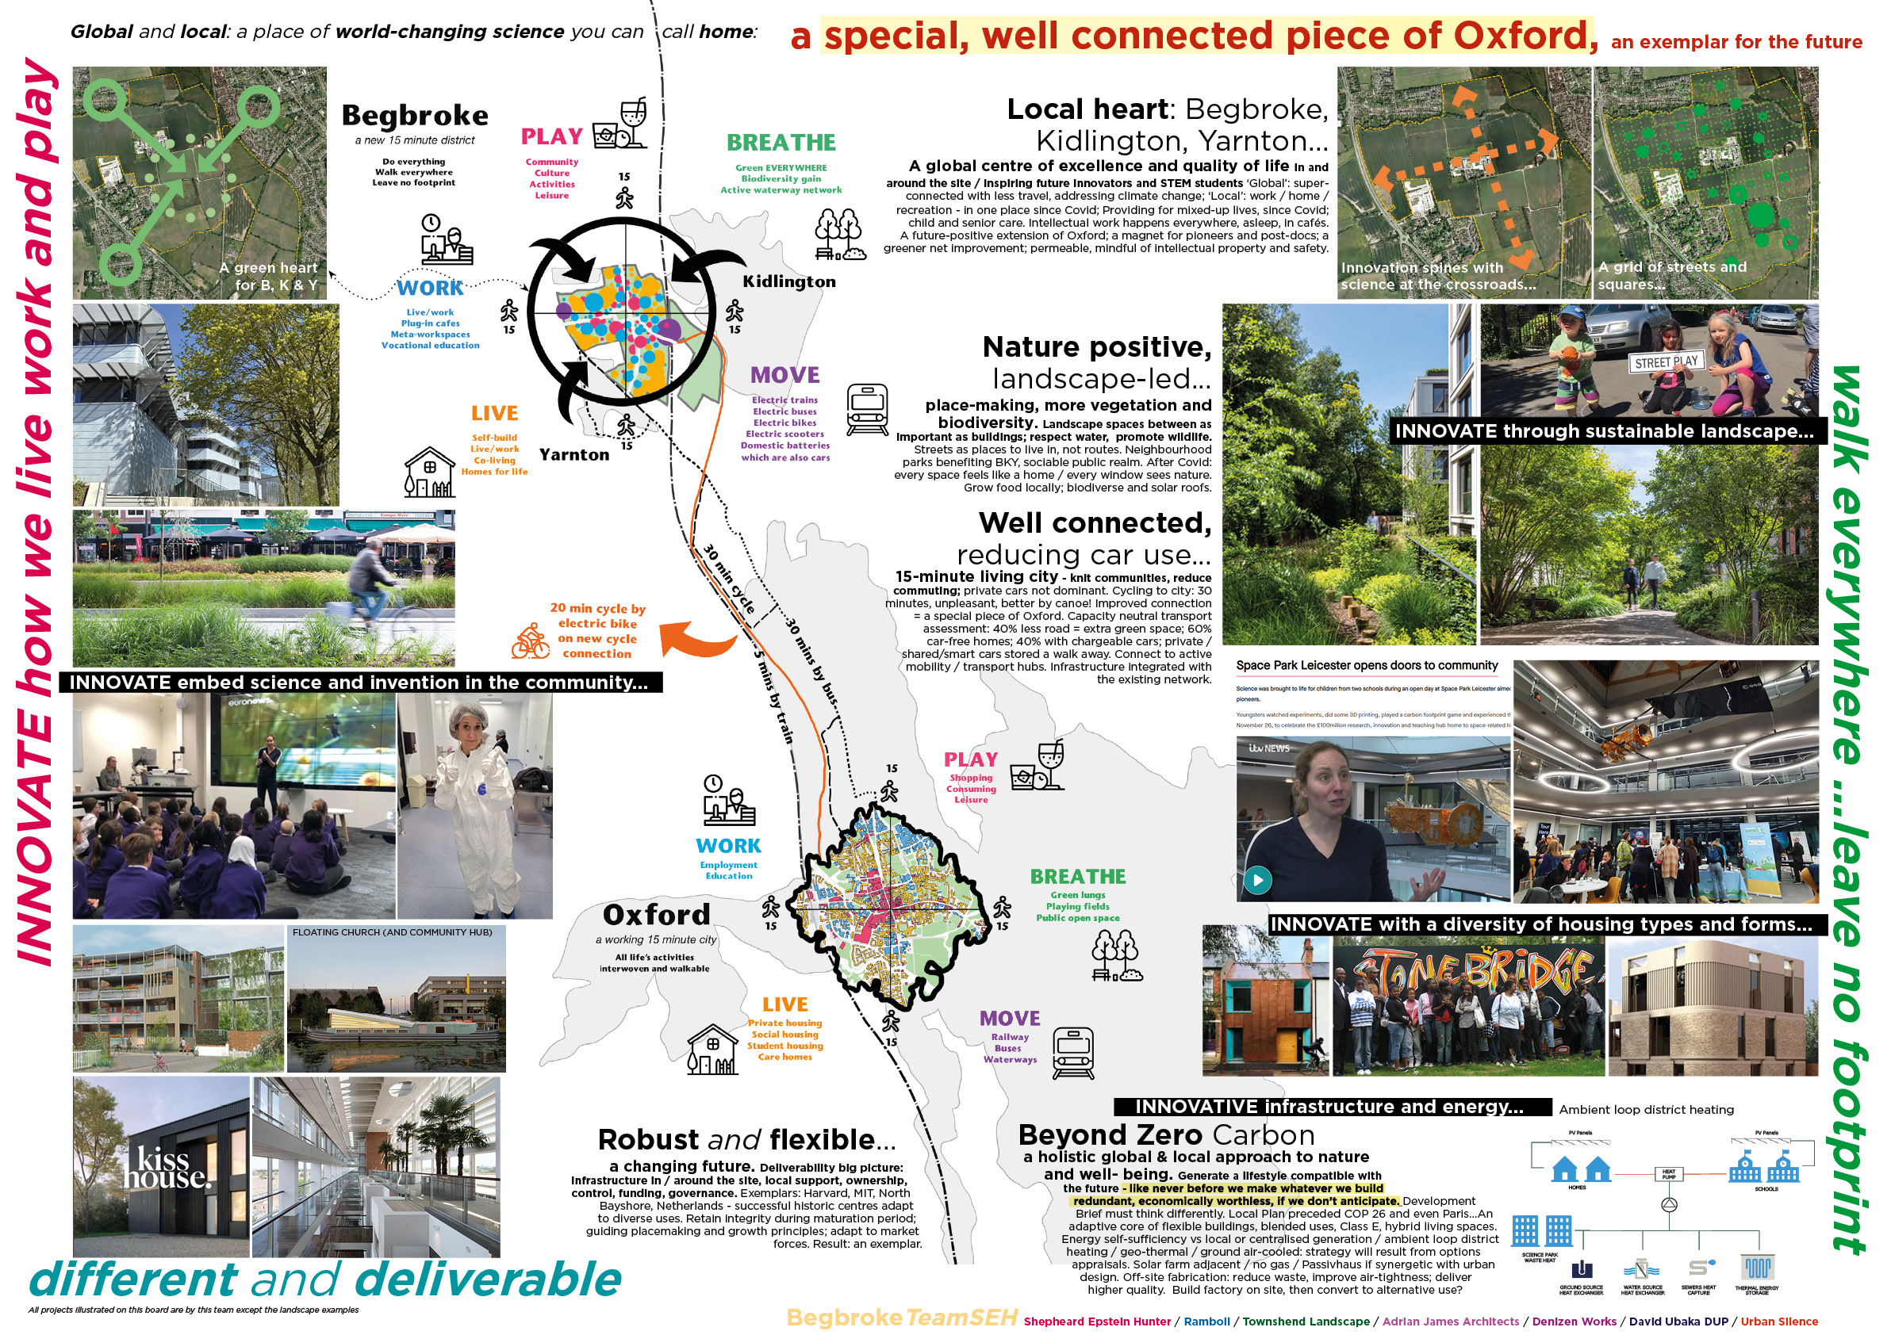

Slide 68
Sheppard Robson
KCAP (Netherlands); Townshend Landscape Architects; BuroHappold;
ORSA; Serie Architects; Studio Woodroffe Papa

Slide 69
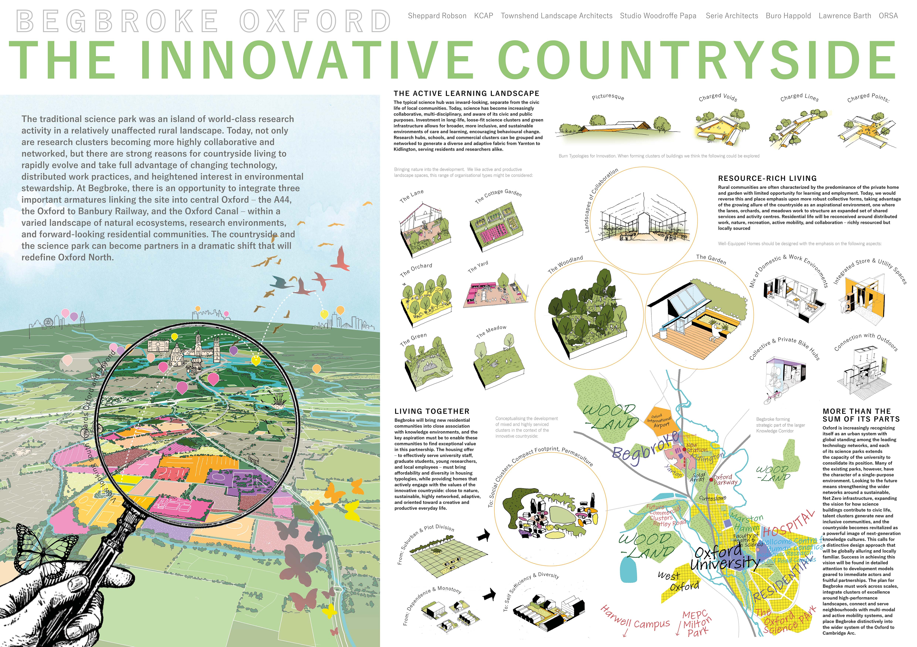

Slide 70
SOM
TSH Architects (Oxford); LUC;Hoare Lea

Slide 71
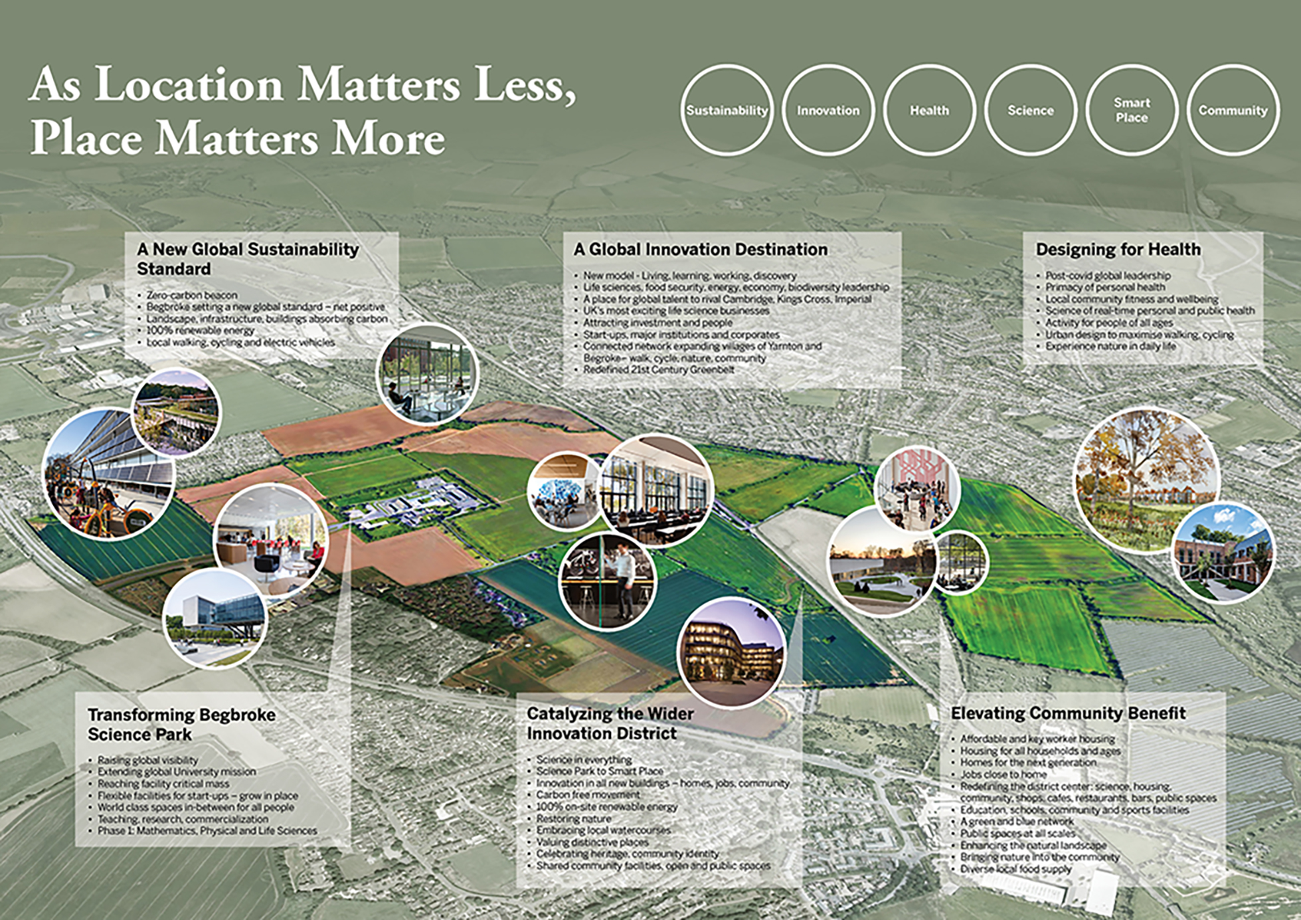

Slide 72
Sour
Buro Happold; Balmori (USA); Applied; Open Inclusion; Cross Works;
David Staley (USA); Sue Stuart-Smith (Oxford); Quemuel Arroyo (USA)

Slide 73
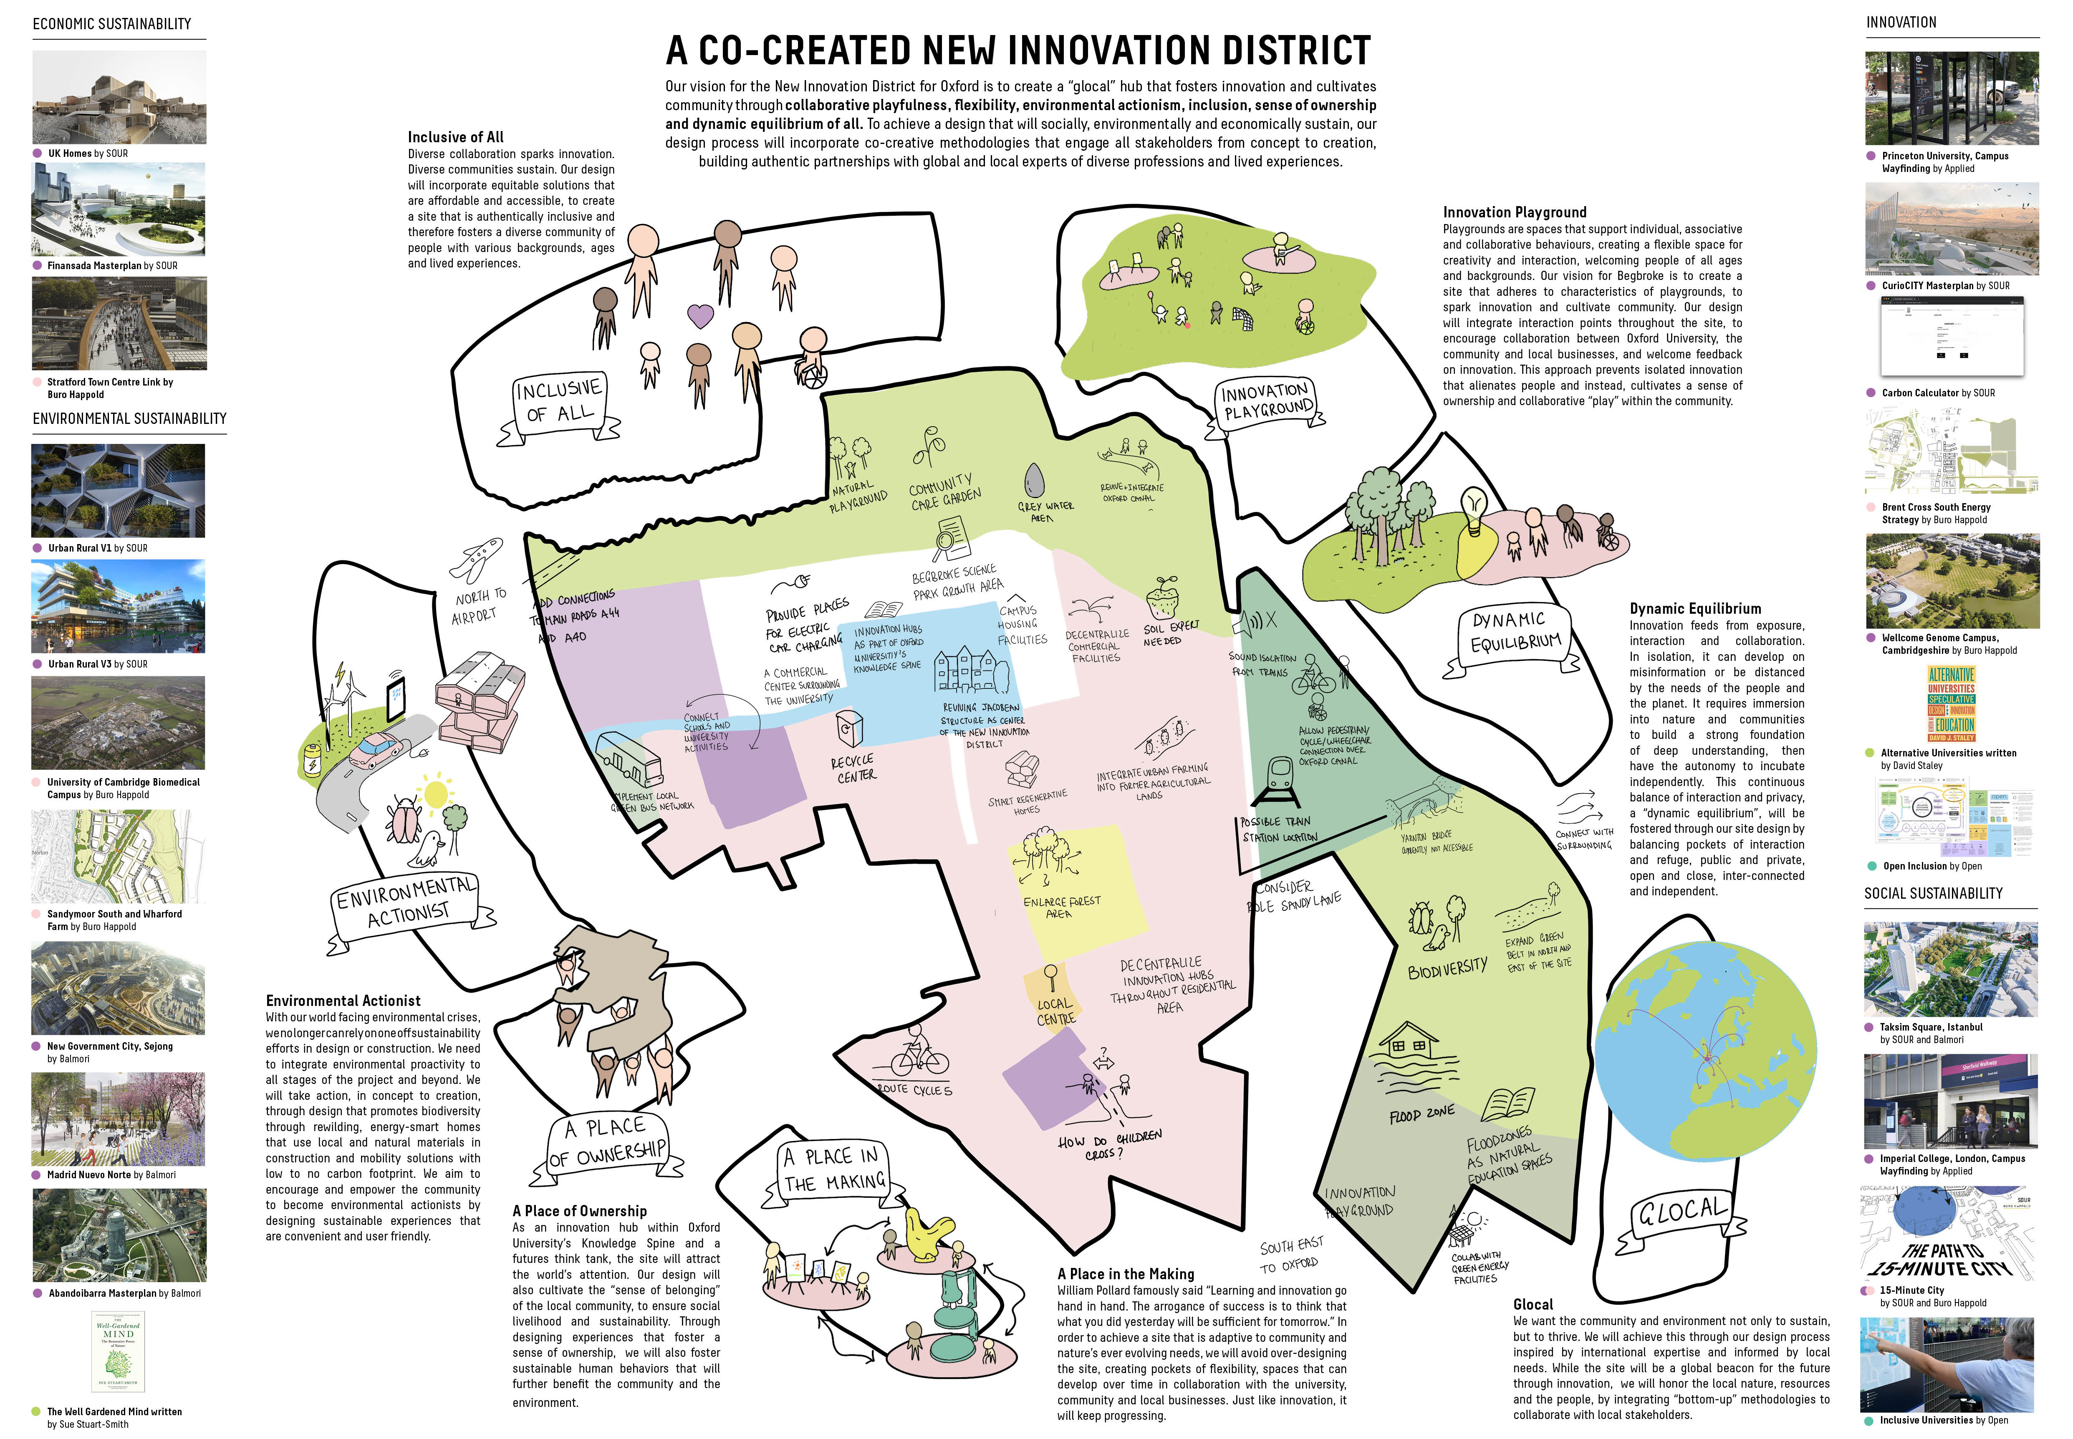

Slide 74
Weston Williamson
Buro Happold; Balmori (USA); Applied; Open Inclusion; Cross Works;
David Staley (USA); Sue Stuart-Smith (Oxford); Quemuel Arroyo (USA)

Slide 75
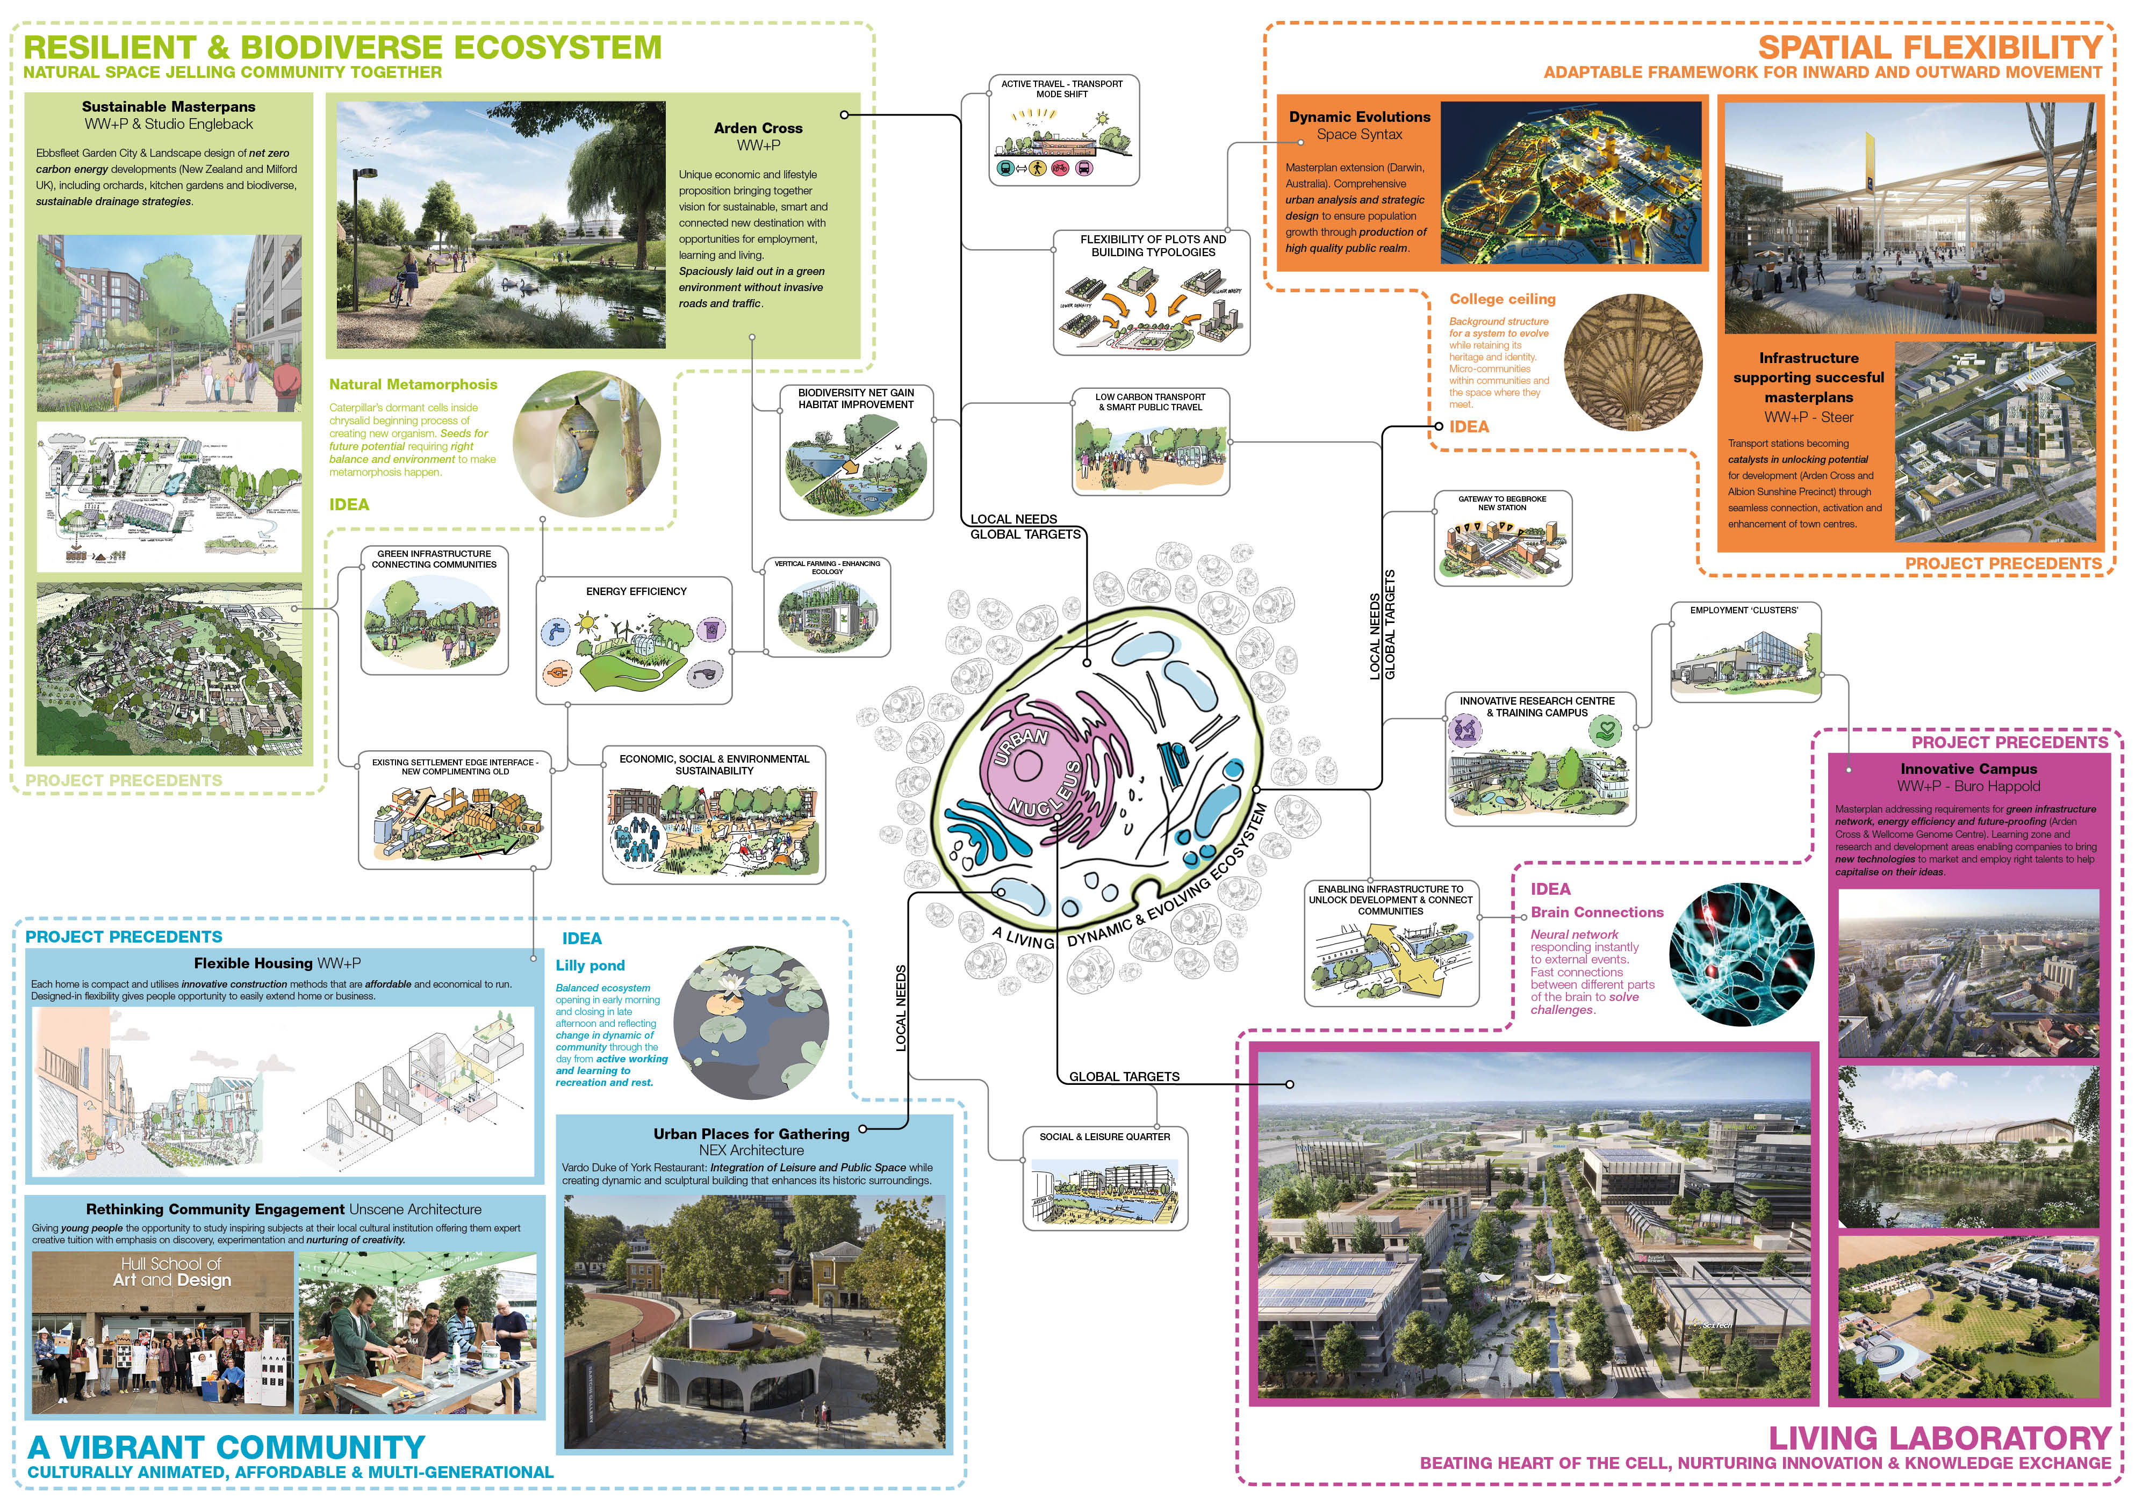

Slide 76
White Arkitekter
Haptic; Mikhail Riches; BuroHappold; Aurora;, Integrated Transport
Planning; William Matthews Associates; 2-3 Degrees

Slide 77
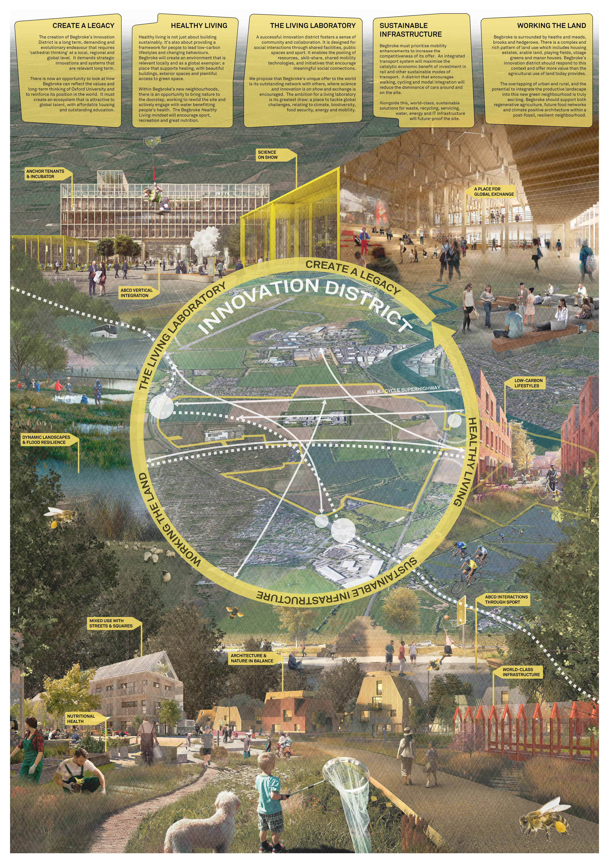

Slide 78
Woods Bagot
Mandaworks (Sweden); ERA-Co; BuroHappold; Moxon Architects;
Momentum Transport Consultancy; Jason Bruges Studio; Stantec

Slide 79
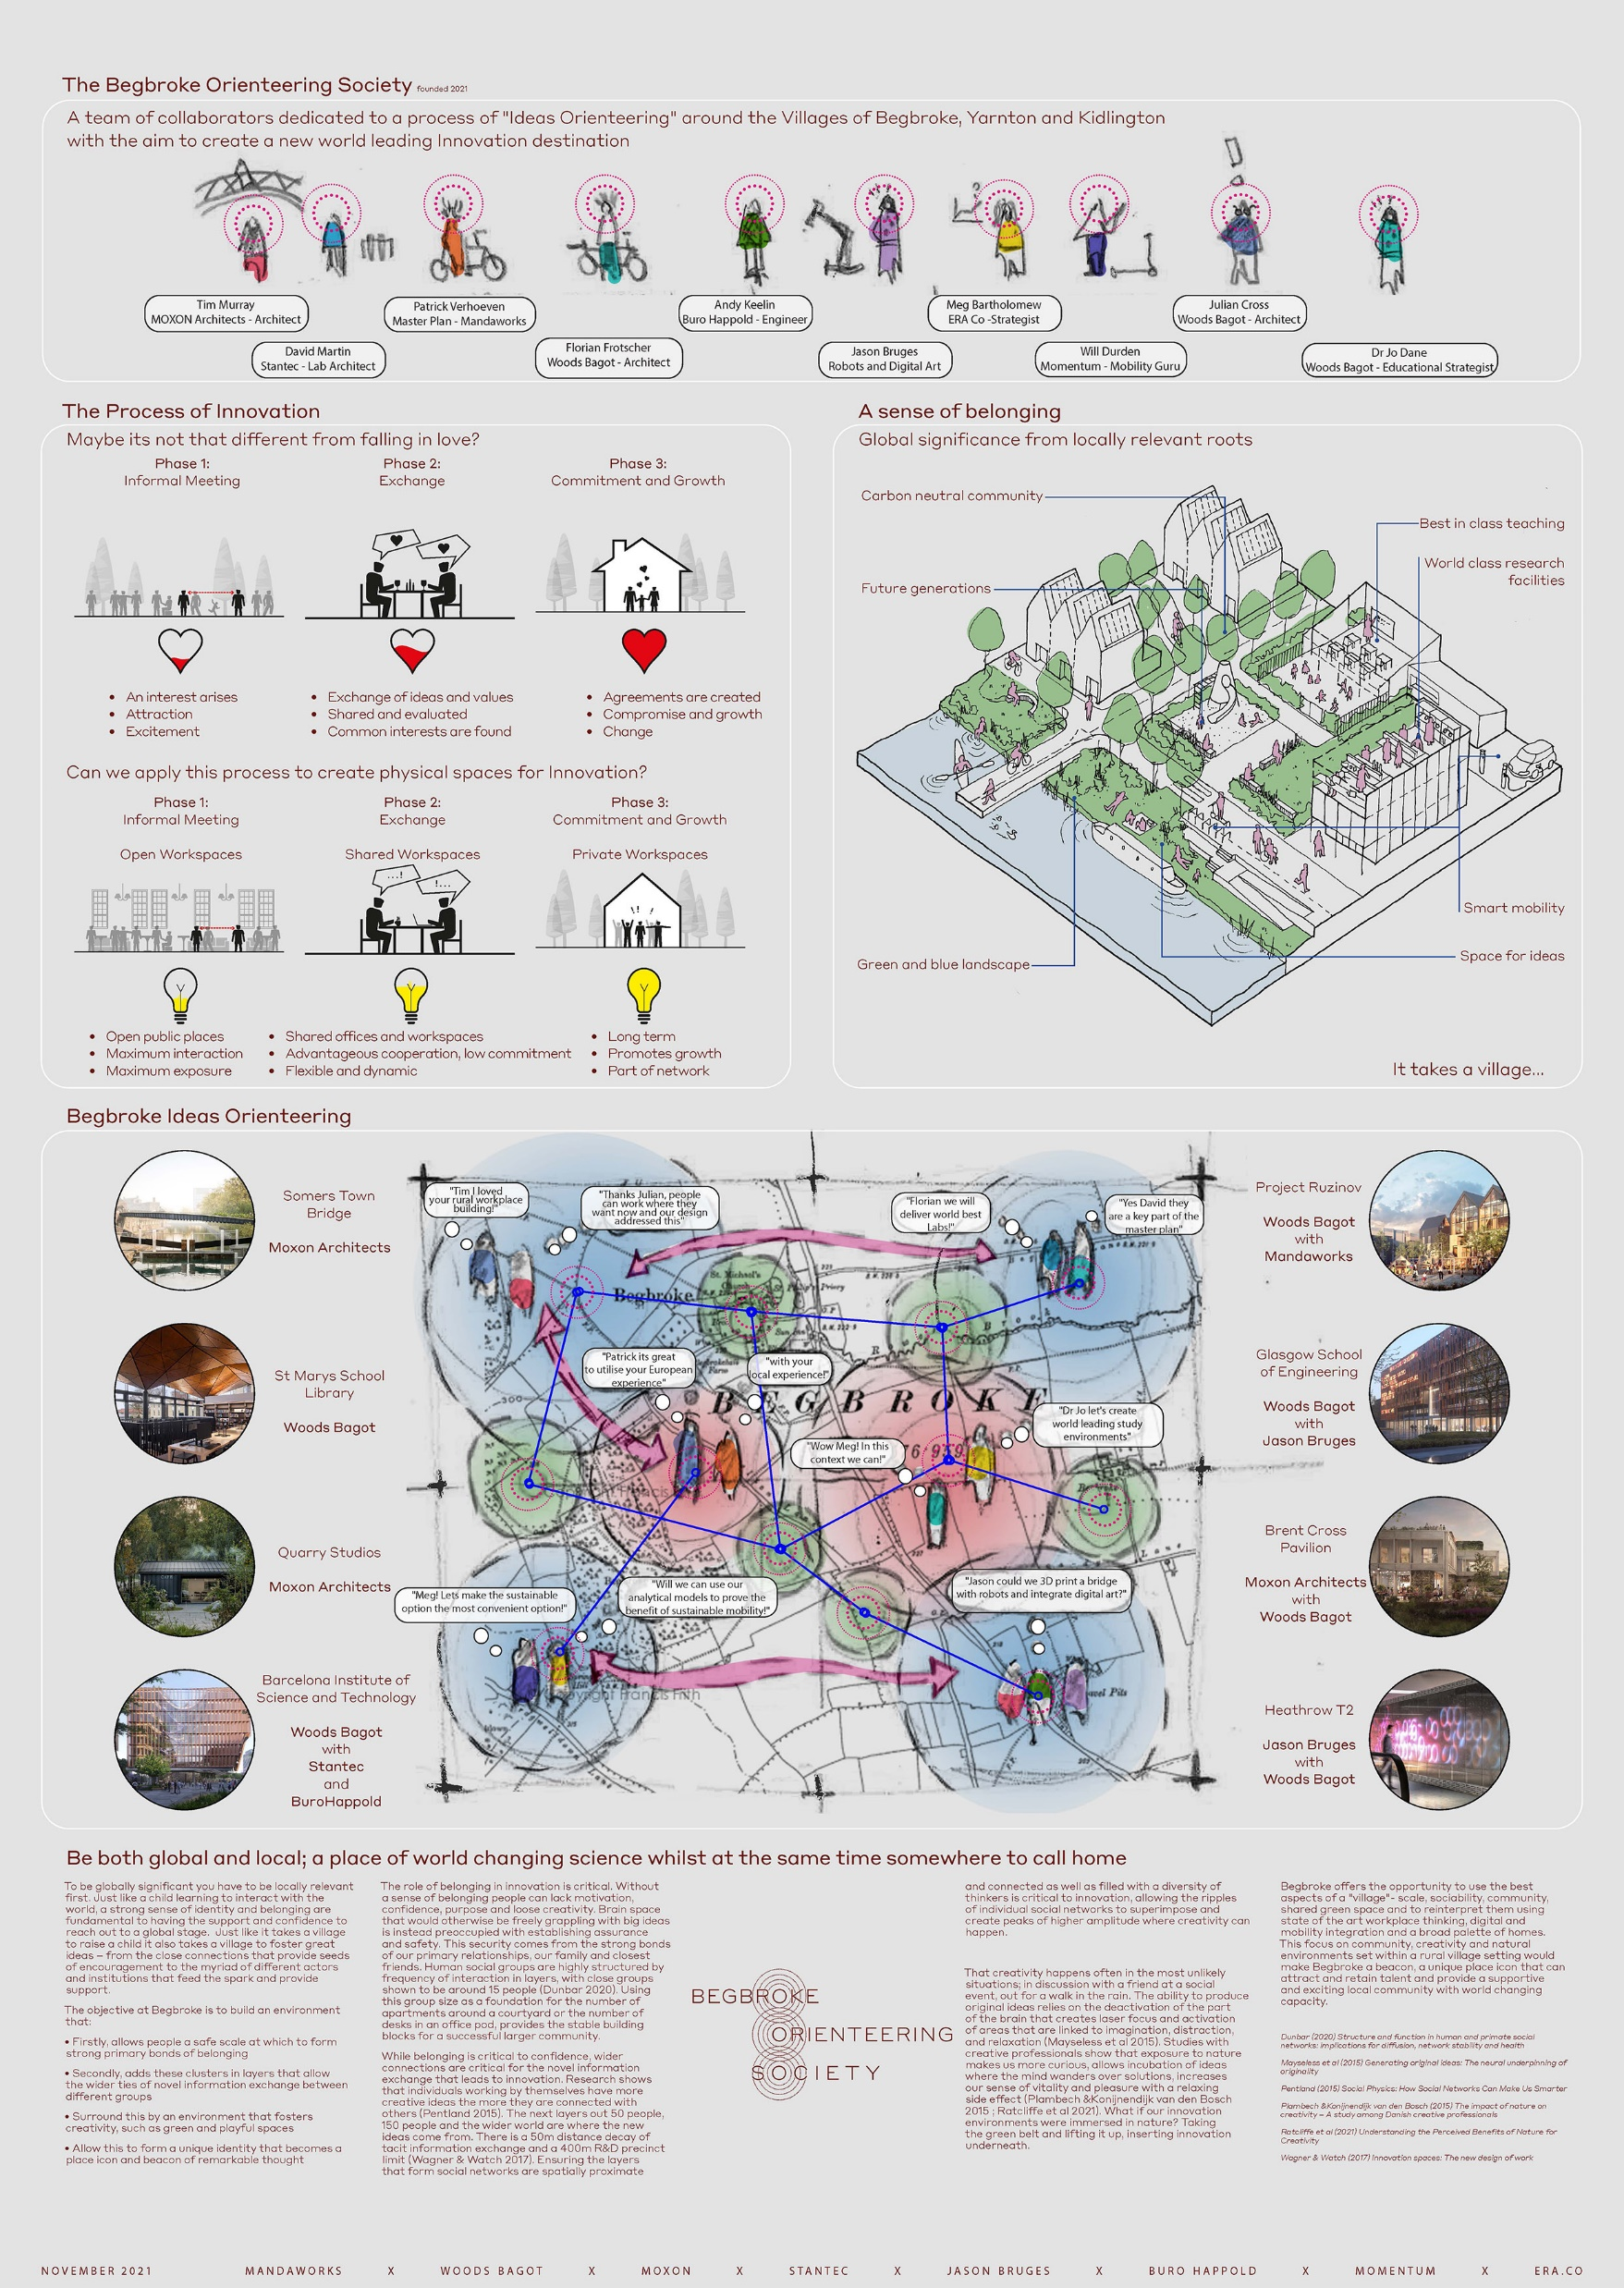

Slide 80
XDGA
Inside/Outside Landscape Design (Netherlands); SWECO; Neiheiser
Argyros

Slide 81
